Slide 1
PM LI2S-MC Overview
Margaret "Peggy" Toth, Program Manager
Presentation to AFCEA Quantico Chapter
01 December 2022

Slide 2
Mission Statement
  Mission Statement: We sustain and transform the Marine Corps logistics information technology capability
  The four pillars upon which our mission and our work reside:
  Logistics: The recognition that our reason for existing is to enable the highest performance and readiness of Marine Corps logistics operations.
  Integrated: The recognition that everything we do, and everything we deliver, must be integrated into a cohesive and seamless capability set for our Marines.
  Information: The recognition that information technology services are relevant, cutting-edge, and user focused for our Marines.
  Solutions: The recognition that we do not deliver products, we deliver solutions to our Marines
  Vision: PM LI2S-MC will deliver a state-of-the-art system of systems and services that provide a deployable, single point of entry in support of USMC logistics operations world-wide.
Notes:
2

Slide 3
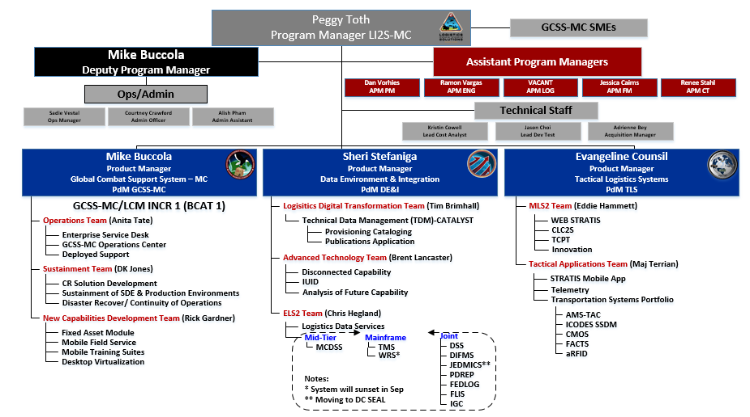
LI2S-MC Organization Chart

Slide 4
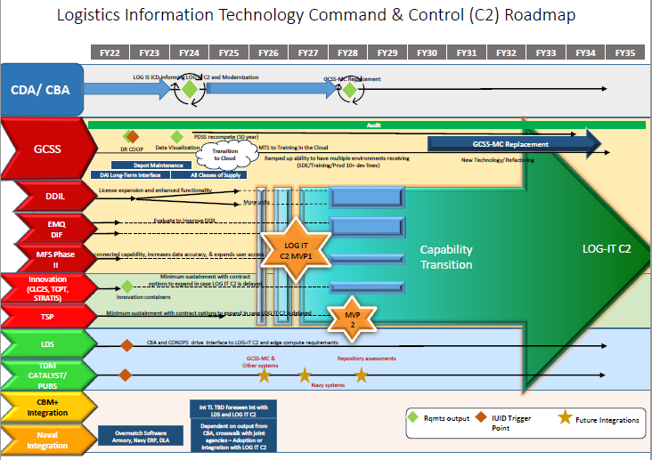
PM LI2S-MC Portfolio Roadmap

Slide 5

PdM Global Combat Support System – Marine Corps (GCSS-MC)
GCSS-MC Mission
To develop and implement deployable, leading-edge technology that enables logistics modernization and maximizes combat effectiveness of the Marine Corps through improved logistics visibility
GCSS-MC Vision Statement
High performing professionals delivering the most advanced, intuitive, reliable and capable system to support the Marine Corps logistics operations
PdM GCSS-MC & Staff
Operations Team manages daily GCSS-MC operations to support System Users. Responsibilities include: deployed operations support, GCSS-MC Operations Center, Enterprise Service Desk, Continuity of Operations Planning and Training.
Sustainment Team ensures GCSS-MC meets operational performance expectations and system services are available to GCSS-MC Users. This includes hardware/software management, obsolescence, tech refresh and interface performance/ management
New Capabilities Development Team manages the development and deployment of all new capabilities. NCD Team efforts include: Fixed Asset Module, Mobile Field Service, E-Mail Mobile Query, and Desktop Virtualization.

Slide 6
GCSS-MC Overview (cont’d)
PROD External
Interfaces
Commercial
Internet
NIPRNet/MCEN
PDSS Contract
WAF
SDE
(Irvine, CA)
Riverbed
DISA GCDS (Akamai)
Build Packages
Gold Disk
PSS/PROD
(Kansas City, MO)
Training
Packages
Training Portal/Content
Mobile Training Suites
COI Extension
MarineNet
DR/COOP
(Oklahoma City, OK)
Enterprise
Service Desk
Operations Center
Systems Management
Cyber Security
Agile Software Development
Warranty & License Procurements
IT Infrastructure Library

Slide 7

PdM Data Environment & Integration (DE&I)
DE&I Mission
Dedicated to providing the Marine Corps logistics community with transformational capabilities that will streamline business processes, improve data quality and greatly enhance overall user experience.
DE&I Vision Statement
Offer analytical capabilities to unify and integrate data from disparate sources to produce effective, actionable business intelligence throughout the logistics chain of command.
PdM DE&I & Team
Advanced Technology Team
is developing capability that provides the Marines the ability to store and synchronize data when reliable data connections are poor or unavailable due to network or combat scenarios and
capabilities required to support the identification and tracking of tangible government property using UII.
Logistics Data Transformation (LDT) & Enterprise Logistics Support Services (ELS2)
    An adaptive enterprise Technical data, Configuration Management, and Logistics Product Data lifecycle management capability used to provide data integrity, visibility, standardization, and interoperability with internal Marine Corps and external DoD systems. Developed and deployed on a flexible, cloud-based data platform using low-code rapid application development supported by an Agile Software Life Cycle Development model.
    Logistics Data Service (LDS)
    seeks to meet the Marine Corps’ needs as defined in the 38th Commandant’s Planning Guidance (CPG) to make strategic investments in data science, machine learning and artificial intelligence. To that end LDS has partnered with Marine Corps’ Business Operations Support Service (MCBOSS) to provide secure Amazon Web Services (AWS) Government (GOV) Cloud hosting site to ingest, store and serve the Marine Corps’ Logistics data from a core platform.

Slide 8
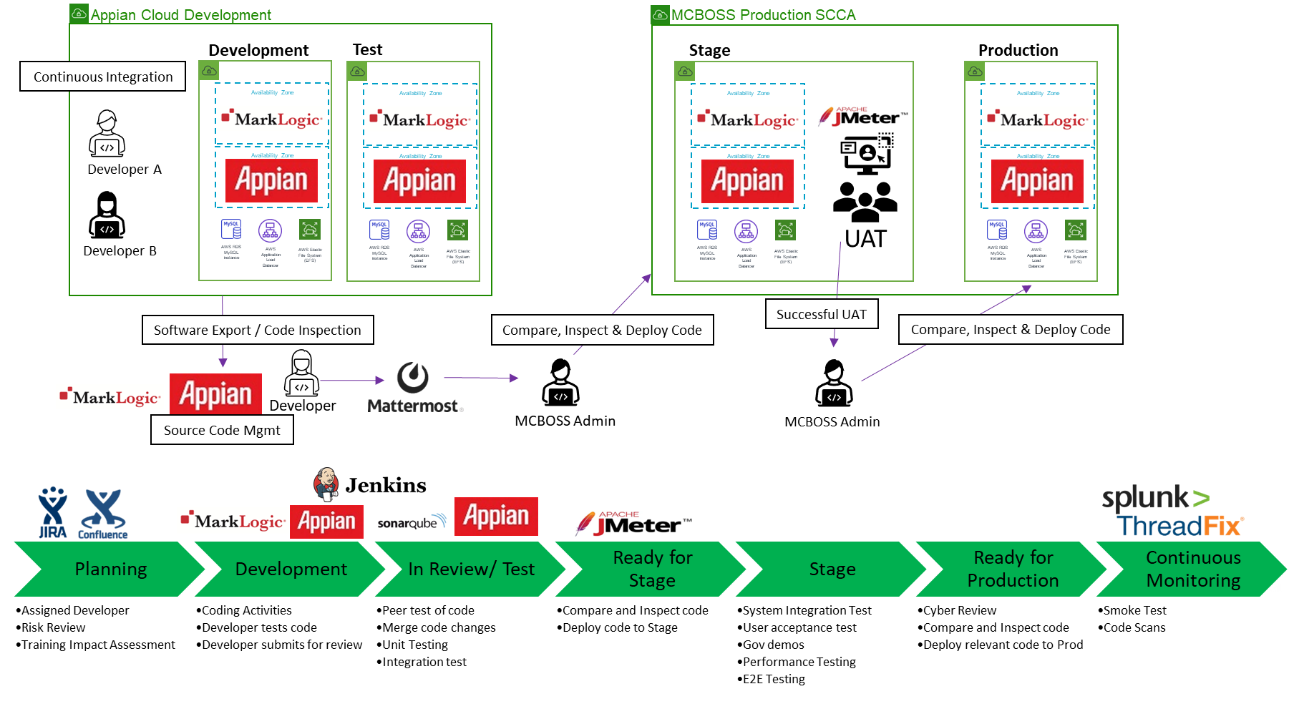
TDM Architecture and Engineering
MCBOSS PaaS leveraged for Stage and Production environments.
Development occurs in the Appian Cloud.
Configuration file deployments occur as needed, but minimum biweekly.
Multiple tools leveraged to automate the DevSecOps Pipeline
Testing/Quality Assurance is a discipline executed during all phases and processes.

Slide 9
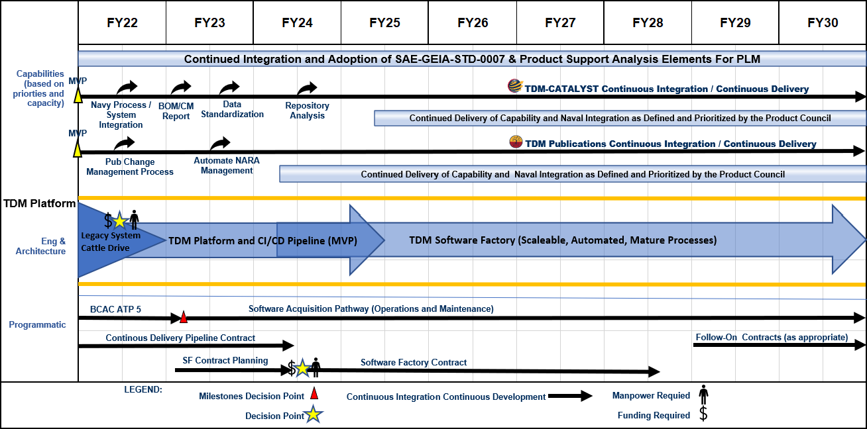
TDM Strategic Roadmap
FY23 and beyond includes the design and integration of future Product Support Elements (PSE) and management functions based on team capacity and the priorities of our stakeholders.
Notes:
The verbiage is pulled out of the CIP Section 1.1

Slide 10
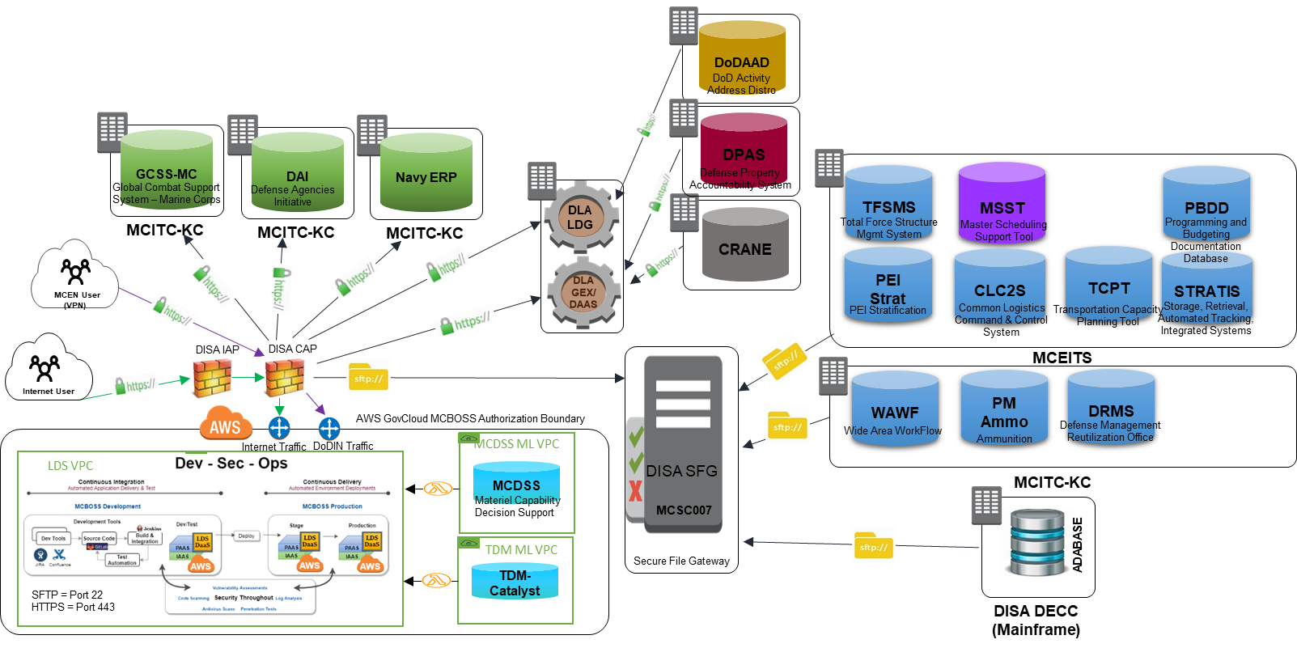
Logistics Data Services (LDS)

Slide 11
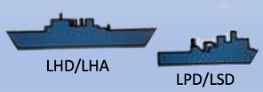


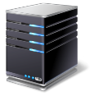
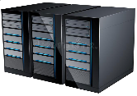



DDIL MC Log
Mission: DDIL MC Log extends access to GCSS-MC capabilities and provide GCSS-MC users continuity of operations for logistics business processes conditions to all operational environments, specifically to disadvantaged networks and disconnected environments. This capability provides critical functionality to operate under austere network conditions.
Denied Degraded Intermittent Low-bandwidth (DDIL) Network
GCE
(On the Move)
MEU Ashore
MEU
Afloat
GCSS-MC
Enterprise
Garrison Network
DDIL EDGE
DDIL EDGE
Browser
Organic Satellite
Browser
DDIL
Enterprise @ MCBOSS
GCSS-MC
Enterprise
Mobile
Mobile
11

Slide 12
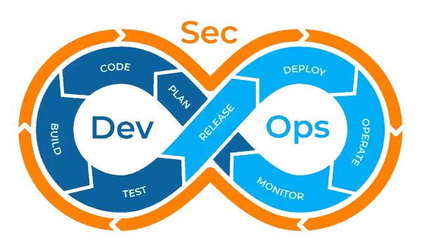
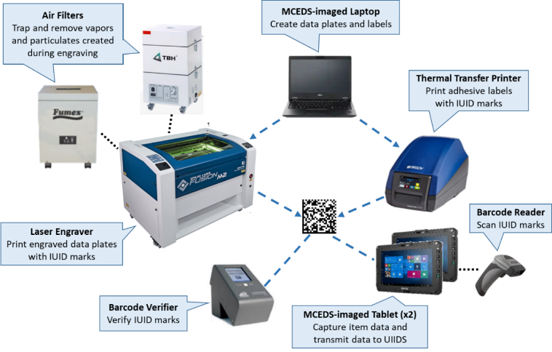

UIIDS
@ MCBOSS
UIIDS
GCSS-MC
IUID OSD Registry
GEX
Live Cycle Events
Add &
Update Items
Item Identification
Create
Sustain
Mark
Register
Update
IMC / Print UII
AIT / Scan UII
Users
Integrated Marking Cart (IMC)

Slide 13
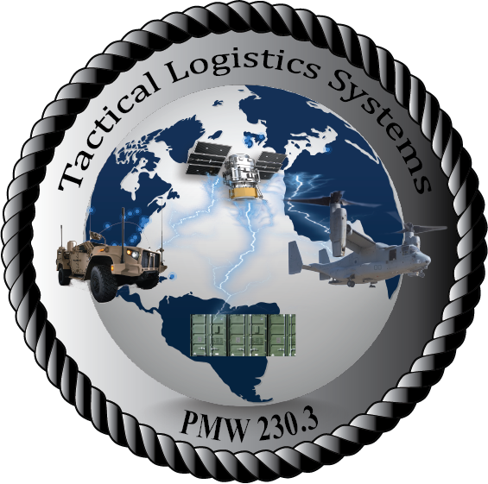
PdM Tactical Logistics Systems (TLS)
Mission
To develop, sustain and deploy enterprise and disconnected mobile logistics information technology tools in support of garrison and operational forces in low bandwidth/degraded environments. Tactical Logistics Systems will provide enhanced visibility for commanders dashboard, transportation management and warehousing and inventory management systems thereby increasing logistics visibility and capability to the Marine Corps.
MAGTF Logistics Support Systems (MLS2)
Manages the MLS2 systems (STRATIS, TCPT, CLC2S) which are used throughout the MAGTF to fill critical information gaps essential for effective combat services support and C2 in support of logistics operations. Capabilities provided include feasibility of support, rapid request for logistics and services, asset visibility, tactical warehousing, transportation tracking, master logs, and logistics dashboards. Current efforts include innovation efforts that include containerization, data synchronization and data sharing to automate movement of data among MLS2 systems.
Tactical Applications (TACAPPS)
Manages mobile application enhancements, enabling users to fulfill full-spectrum of TLS operations with increased mobility and performance in tactical, disconnected and degraded environments. In addition, the portfolio includes Transportation Systems applications which supports sustainment and CR backlog of four MAGTF logistics systems and Telemetry which is a suite of logistics applications supported by a centralized data analysis and processing engine.

Slide 14
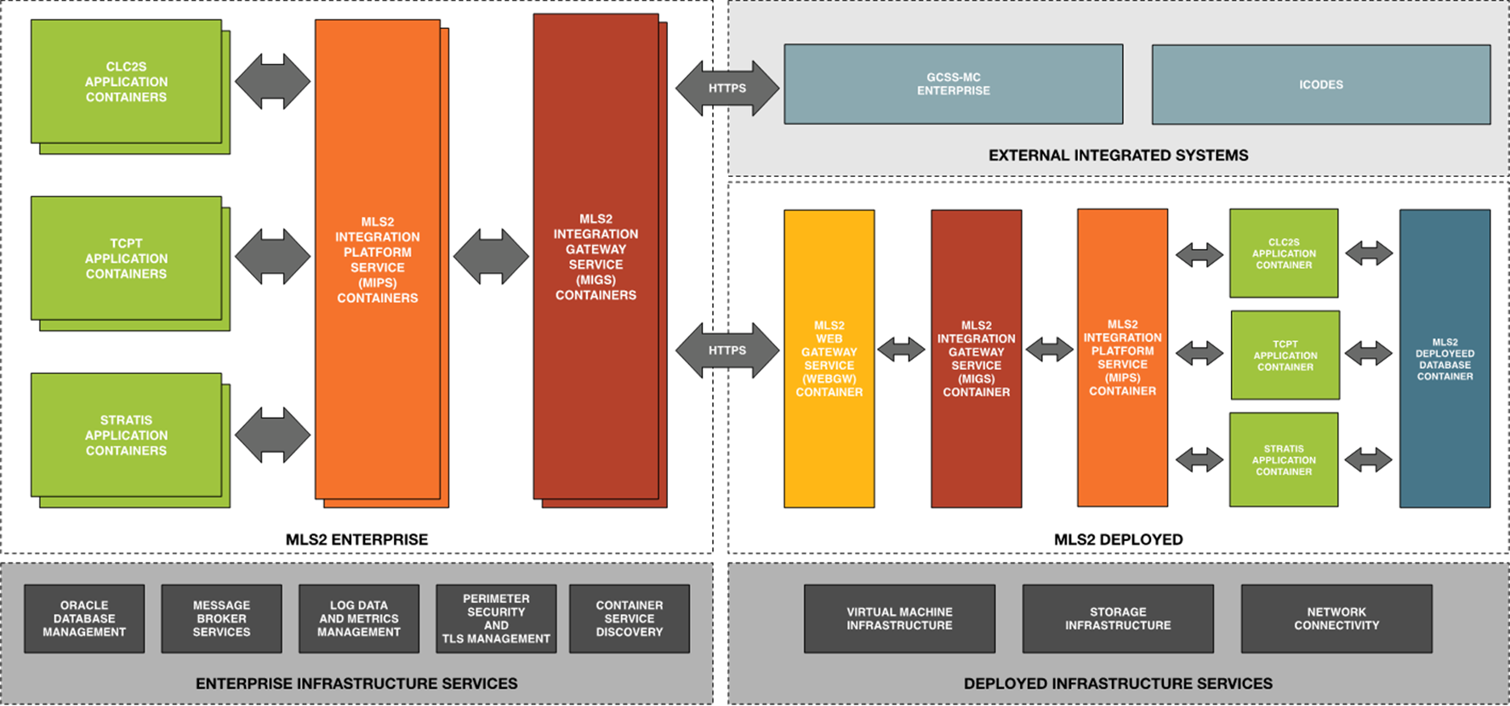
MLS2 Architecture

Slide 15
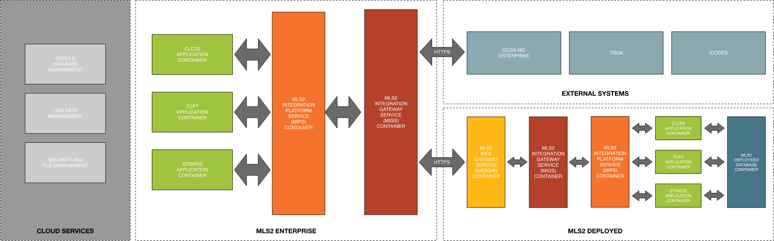
MLS2 Innovation Component Architecture

Slide 16
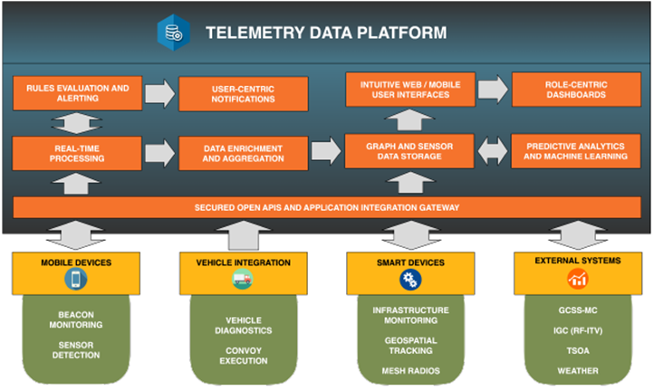
Telemetry Overview
Telemetry capabilities will provide in-transit visibility (ITV), end to end visibility of USMC logistics activities by interfacing with data sources such as GCSS-MC, and IGC. MVP for Telemetry will include 5 interfaces with existing Marine Corps systems providing an integrated Common Operational picture to provide key information on assets and movements in one system.
Telemetry provides flexibility to integrate with multiple platforms, and systems to improve situational awareness and serve as a key decision making tool.

Slide 17
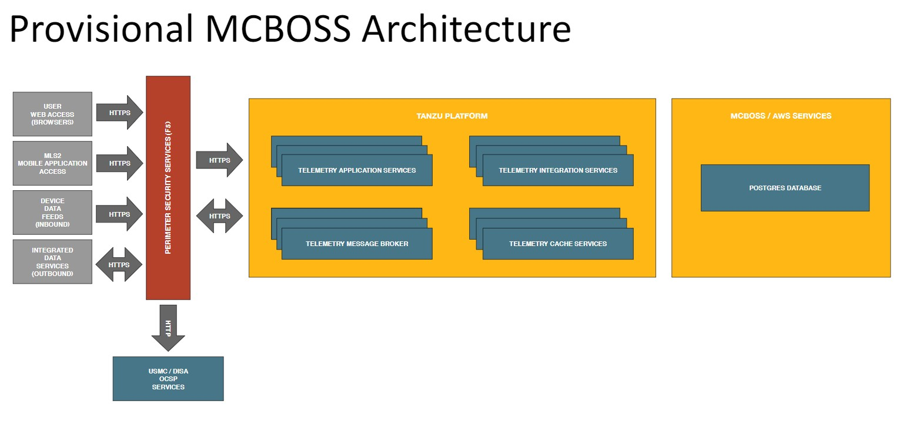
Telemetry Cloud Overview
Telemetry uses modern cloud technology and the TANZU DevSecOps environment to streamline development, delivery and Security.
Telemetry will utilize continuous ATO once the production environment is complete. Currently the Application is being deployed to the MCBOSS Staging environment and is schedule to go live May 2023.

Slide 18
Opportunities

Slide 19
MAGTF Logistics Support Systems (MLS2)
Description/Summary of Program Requirements
Program Management Warfare 230 (PMW-230), Logistics Integrated Information Solutions-Marine Corps (LI2S-MC)
– Marine Corps (LI2S-MC) has a requirement for to provide sustainment, system maintenance and operational support functions commonly in the support and operations phase of system’s lifecycle and maintaining current and future system interoperability.
Acquisition Strategy
  Under Development/Changes
  RFP#: M67854-23-X-76XX
  Five year base IDIQ with task orders; small business set aside
Current Contract / Original Developer / OEM (if Recompete)
  M67854-18-D-7601
  Tactical Edge
Milestones
  RFI Release: N/A
  RFP Release: FY23 Q2
  Proposal Due date: FY23 Q2
  Estimated award date: FY23 Q4
Period of Performance
  5-year ordering period (2023-2028) +52.217-8
  Individual Tasker Orders
Points of Contact
  Contracting Officer: Renee S. Stahl, renee.stahL@usmc.mil
  Contract Specialist: Capt. Bret Bockenstedt, bret.bockenstedt@usmc.mil

Slide 20
Garrison & Tactical Operations Support (GTOS)
Description/Summary of Program Requirements
Program Management Warfare 230 (PMW 230) - Logistics Integrated Information Solutions-Marine Corps (LI2S-MC) manages a portfolio of systems that support the logistics elements of command and control, interoperability, and secure access to and visibility of critical data. The PMW 230 portfolio includes the GCSS-MC/Logistics Chain Management (GCSS-MC/LCM) enterprise resource planning system.
Acquisition Strategy
  RFP#: M67854-23-Q-76XX
  Small Business Set-aside, Non-Commercial Services, SeaPort-NxG
Current Contract / Original Developer / OEM (if Recompete)
  M67854-19-F-3506 / CommIT
Milestones
  RFP Release: FY23 QTR1
  Proposal Due date: FY23 QTR2
  Estimated award date: FY23 QTR2
Period of Performance
  March 2023
  12-month base, 12-month option, +52.217-8
Points of Contact
  Contracting Officer: Renee S. Stahl, renee.stahl@usmc.mil
  Contract Specialist: Allen Logan, all.logan@usmc.mil

Slide 21
Program Office Support Services
Description/Summary of Program Requirements
Program office support in the areas of program management, acquisition, technical, logistics, and administration for PMW 230 (PM LI2S-MC).
Acquisition Strategy
  RFI#: TBD
  RFP#: TBD
  Strategy: Under Development
Current Contract / Original Developer / OEM (if Recompete)
  M67854-17-F-3002 / ReMilNet
Milestones
  RFP Release: FY23 QTR3
  Proposal Due date: FY23 QTR3
  Estimated award date: FY23 QTR3
Period of Performance
  June/July 2023
  Under Development
Points of Contact
  Contracting Officer: Renee S. Stahl, renee.stahl@usmc.mil
  Contract Specialist: Kassidy Probst, kassidy.probst@usmc.mil

Slide 22
GCSS-MC Post-Deployment Support Services (PDSS)
Description/Summary of Program Requirements
Provide Post Deployment System Support (PDSS) for the Global Combat Support System – Marine Corps/Logistics Chain Management (GCSS-MC/LCM) Enterprise NIPRNET V2.X system; henceforth, referred to as GCSS-MC/LCM Enterprise. The scope of support includes: Service Management, Service Operations (Enterprise Service Desk and GCSS-MC Operations Center (GOC)); Production and Pre-Production System sustainment; Solution Development Environment; Enterprise Training & Training Devices; Product lifecycle Service Transition for Change Requests (CRs), Engineering Change Proposals (ECPs), Mobile Training Suite (MTS), Reports, Interfaces, Customizations, Extensions, Configurations, Personalization's, and Workflows (RICECPW), cloud migration and support, cloud study, and potential tasks to support GCSS-MC future initiatives.
Acquisition Strategy
  RFI#: M67854-22-GCSS-PDSS
  RFP#: TBD
  Full and Open Competition, FPI/FFP/COST
Current Contract / Original Developer / OEM (if Recompete)
  M67854-19-D-7614
  CACI - Federal, Inc.
Milestones
  RFI Release: FY22 QTR 3
  Industry Day: FY23 QTR 1
  RFP Release: FY23 QTR 4
  Proposal Due date: FY23 QTR 4
  Estimated award date: FY24 QTR 2
Period of Performance
  10-year ordering period
  5-year base, 5 option years
  Dec 2024 - Dec 2034
Points of Contact
  Contracting Officer: Barbara Hawes / barbara.hawes@usmc.mil
  Contract Specialist: Teri Snyder / teri.snyder@usmc.mil

