Slide 1

A Next Generation National Security Company

Slide 2
VISION
MISSION
To be the company national security customers consistently rely on
to solve their most daunting challenges,
to create novel solutions supporting their most vital missions, and
to manage their most valued assets
  To protect and promote freedom around the world, by:
  Securing our future
  Connecting our world
  Safeguarding our enterprise
  Protecting our borders
  Enabling commerce
  Enhancing human knowledge
  Protecting our citizens
Vision & Mission

Slide 3






Core Values Formed a Critical Foundation for Success
HONOR
TEAM
TRUST
RESPECT
INNOVATION
EXCELLENCE
Honor those we serve
Maintain selflessness
for the team
Operate with
integrity and trust
Treat others with respect
Constantly innovate
Deliver excellence in
value and capability
We do not take lightly the responsibility we have assumed in supporting our national security
We give first to the team and expect nothing in return
We demand trust in every way from our leaders and our employees
We treat each other with courtesy, dignity and respect
We show initiative and creative thinking
We work relentlessly to obtain the highest quality results
Our armed forces – soldiers, sailors, airmen and marines – have the courage to show up, to leave their families for something bigger than themselves. What they do for our nation is something bigger than ourselves, and through their services, we will pass on to our children the world's greatest nation, just like the one we got from those who gave so much before them.
Team success breeds personal success. We act for the team first, and for individuals, afterwards. Team is the sine qua non of mission and company success.
From the quality of our services, to the way in which we make decisions, customers and partners must be able to count on our trust. Trust is the currency of leadership, the pulse of a company, and the motto for a nation. We must trust each other, and our customers must trust us.
We encourage diversity, inclusion, and the value that is generated from disparate backgrounds and experiences.
We challenge the status quo, embrace change, and solve problems through innovation, agility and creative thinking. We will engage in open debate, explore novel solutions, and continuously seek to better ourselves.
We strive for excellence through continuous improvement and flawless execution.

Slide 4


About Peraton
Impacting missions of consequence across the globe…
  National intelligence collection, analysis & dissemination
  Full spectrum cyber operations and information dominance
  Space protection & resiliency
  Secure, resilient global communications
  Border and maritime security platforms
  International coalition strike platforms
  Hypersonic weapons
  Foreign Affairs
  Citizen health and safety
  Mission-based enterprise IT modernization
…and deep into the far reaches of the galaxy
  Human space exploration

Slide 5



















Creating A Next-Generation National Security Company
KEY HIGHLIGHTS
Top tier government services provider with diversified portfolio
Best in class margin performance
22,000 employees with deep technical talent across all domains
20,000 cleared employees with ~7,500 TS/SCI cleared across hundreds of special access programs
Mission capability integrator in national and global level missions of consequence
Patent portfolio of 470 leverageable patents
Enterprise IT qualifications to address any magnitude program
Integrated Mission
Support & IT
Solutions Business
Defense
Intelligence
Space
Cybersecurity
Civilian
Homeland Security
Health
Risk Decision
Perspecta Labs
Space Domain Awareness
Satellite Ground
Defense Cyber
Enterprise Services
+
National Intelligence
Space Integration
Cyber Warfare
Homeland Security
Health Services
Mobile Services
Global Access
+
+
=
Space
Intelligence
Cyber
Defense
Homeland Security
Communications
2017
2018
2019
2021
2021+…

Slide 6






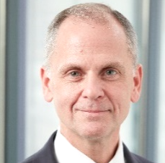
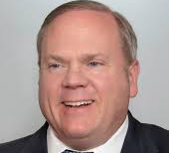

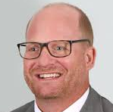
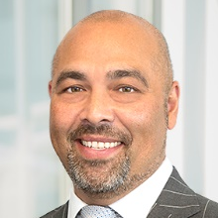
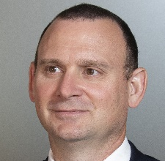
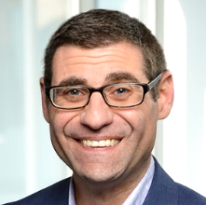
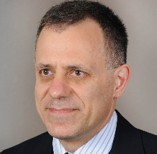

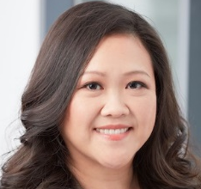
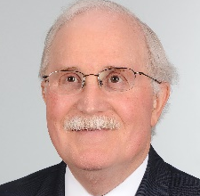


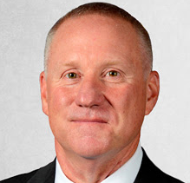

Experienced Leaders With Customer & Mission Intimacy
Peraton
Peraton
Northrop Grumman
Northrop Grumman
Perspecta
Perspecta
Stu Shea
President &
Chief Executive
Officer,
Board Chairman
John Kavanaugh
Executive VP
Chief Financial
Officer
Jeremy Wensinger
Executive VP
Chief Operating
Officer,
Board Member
Jim Winner
Executive VP
Chief Legal
Officer, General
Counsel,
Board Member
Mike King
Executive VP
Chief Growth
Officer
Laila Salguero
Vice President
Chief Human
Resources Officer
(acting)
Dr. Roger Mason
President
Space & Intelligence
Sector
Jeff Bohling
President
Defense Solutions
Sector
Tom Afferton
President
Cyber Mission
Sector
Rocky Thurston
President
Citizen Security &
Public Services
Sector
Tarik Reyes
President
Global Health &
Financial Solutions
Sector
Damian DiPippa
President
Systems Engineering
Sector
Chris Valentino
Senior Vice President
Chief Strategy
Officer
Dr. Petros
Mouchtaris
President
Peraton Labs
Jeremy Fremin
President
Strategic Resources
International
Szu Yang
Senior Vice President
Chief Contracts
Officer
Barry Barlow
Senior Vice President
Chief Information
Officer (acting)
Ted Branch
Senior Vice President
& GM
Navy & Marine Corps
Business Group
Lori Ellis
Vice President
Procurement
Matt McQueen
Senior Vice President
Chief Communications
& Engagement Officer
Laila Salguero
Vice President
Chief Diversity, Equity
& Inclusion Officer
Mike Londregan
Senior Vice President
Chief Security
Officer
Notes:
6

Slide 7












PF Peraton (+ NG Mission IT + Perspecta) at a Glance
~$7.0B / ~$24.4B
Revenue¹ / Current Backlog
1.6x
Book-to-Bill
(LTM 9/30)
~40% / 25% / 35%
CP / T&M / FP
Contract mix²
~90%
Revenue from
prime contracts
~150 / ~1,550
IDIQ vehicles / contracts
~$200B
3-Year
Qualified pipeline
775,000 ft²
SCIF & SAPF facilities
73
Locations
worldwide
~22,000
Employees
~75%
Cleared direct employees
~7,500 TS/SCI
19.8%
Military Veterans
~470
Patents
1-LTM as of 9/30/2020
2-Excludes NGEN and some SETA contracts

Slide 8




What Does it Mean to be a Mission Capability Integrator?
Successful integration of:
  A world class team of professionals
  With a deep knowledge of our customers, their mission, and how they uniquely operate
  An ecosystem of proven processes and tools specific to the needs of a customer and their mission
  And complete capability development, from exploratory R&D, to quick response capabilities (QRC), to full responsibility for delivering a major development program
Motivated by the success of the mission
Accomplished by our agility, ingenuity, commitment, innovation, and being unafraid of the impossible
Combined to Solve Missions of Consequence
Thought Leadership
Ecosystem
Major Acquisition Programs
Mission Operations
People
Quick Reaction Capability
Engineering & Analytic Support
Component, Systems & Subsystems
Tools & Processes
Mission Experience
R&D and Prototypes
Customer Understanding
Ecosystem
Full Range of Capabilities
Elements of a Mission Capability Integrator

Slide 9
Serving high consequence missions on a global scale
Worldwide intelligence collection, processing, storage and secure dissemination
Space protection & resiliency, indications & warning
Technical collection, QRC, reverse engineering
Offensive / defensive cyber operations, information operations & digital forensics
Hypersonic weapons testing, telemetry modeling
Strategic weapons modeling & simulation
Intelligence threat assessments & foreign affairs
Secure, global communications services over satellite, terrestrial, and mobile networks
Digital transformation of large-scale enterprise IT
Avionics maintenance & logistics
Spectrum engineering & electronic warfare
Chem/Bio informatics
Advancing global public health, synthetic biology and medical research
Protection of citizens through development and maintenance of public safety systems
Supporting responses to global pandemics and other public health events including COVID-19, Ebola, AIDS, H1N1, hurricanes and SARS
Air, Maritime and Space operations centers
Integrated logistics support for critical national and international security
Innovative R&D in cyber, machine learning, artificial intelligence, electronic warfare, mobility & wireless, sensor integration, and optics, photonics and quantum computing
Peraton delivers on National Security’s most daunting challenges, the most vital missions, and the most valued assets

Slide 10
Protecting and Promoting Freedom Around the World
#DoTheCantBeDone

