Slide 1


Task Force Aquila Overview
AFCEA Quantico-Potomac Eleventh Annual USMC IT Day
May 27, 2021
Mr. Gaurang R. Dävé
Director, Task Force Aquila
Cyber Technology Officer
Marine Corps Systems Command
DISTRIBUTION STATEMENT A. Approved for public release. Distribution is unlimited.

Slide 2
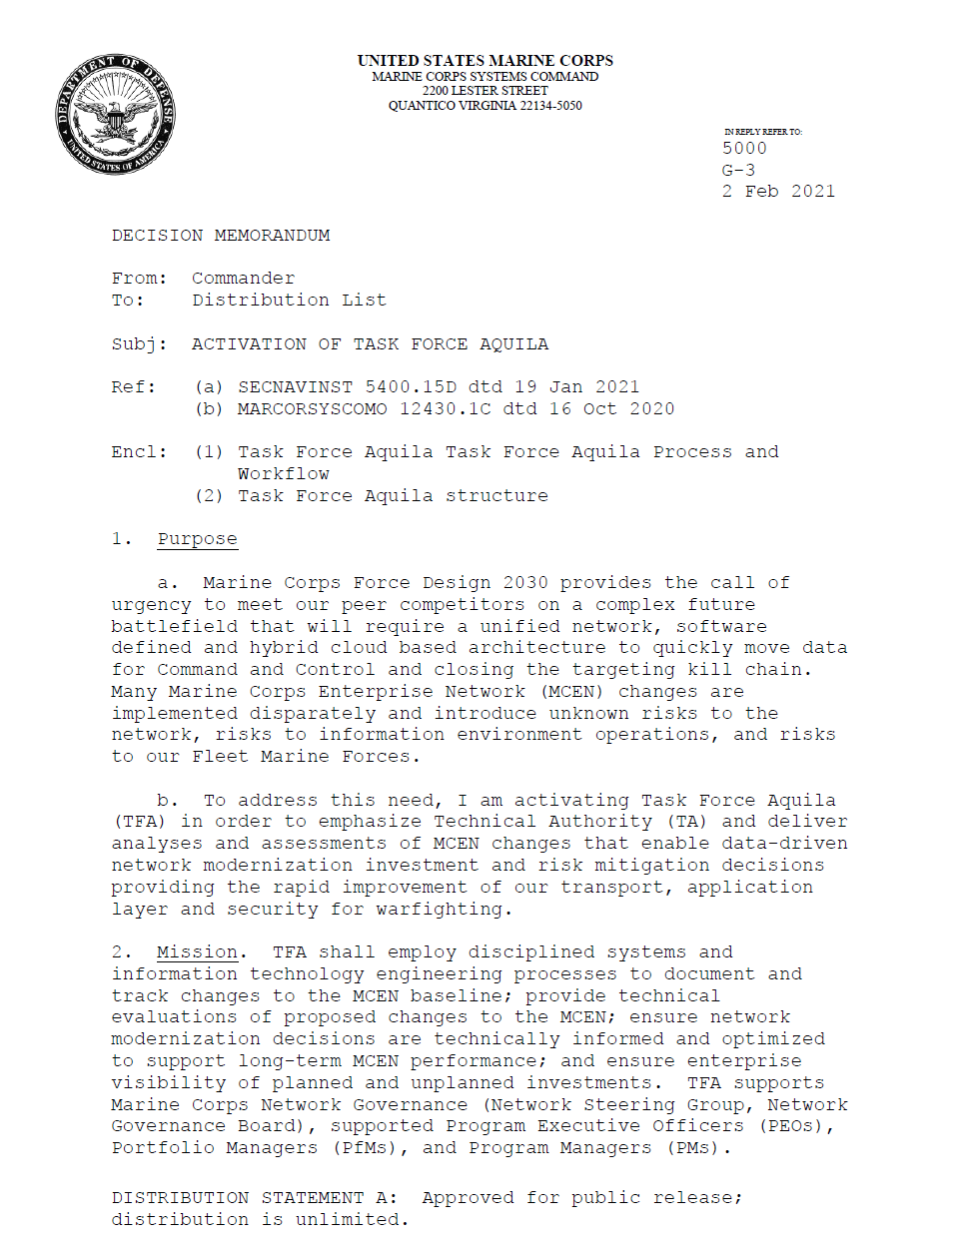
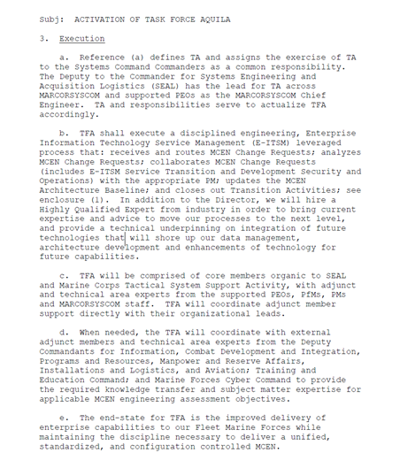
Task Force Aquila
MISSION
TFA employs disciplined systems engineering processes to define and maintain a MCEN Baseline, provide technical capabilities to evaluate changes to the MCEN via a federated MCEN lab, and ensure modernization decisions are technically informed and optimized for the long term performance of the MCEN, in support of MCEN C2 governance and modernization
VISION
Enable the USMC to speed the delivery of network capabilities to the warfighter without sacrificing a unified, standardized and configuration controlled MCEN
CMDR MCSC signed 02 Feb 21, activated TFA to emphasize Technical Authority and bring engineering rigor to the MCEN
Notes:
TFA activation was cost neutral in order to establish some quick wins.
Senior Leader (SL) on board driving TF Aquila Objectives
Highly Qualified Expert (HQE) position offered to selectee, critical to support the transition to new technologies and to gain expert advice on interoperability and integration

Slide 3
Task Force Aquila - BLUF
Enhances enterprise data driven acquisition, investment and divestment decisions by providing engineering analysis, risk assessment and technical recommendations
  Supports the Programmatic Decision Authority and other governing bodies like the NGB
Employs disciplined systems engineering processes through
  Technical Authority (TA)
  Digital Twin (DTw) via Federated Labs
  Model Based Systems Engineering (MBSE) and standards implementation
Integrates a Change Advisory Board structure to assess, prioritize and manage MCEN configuration
  Via the Enterprise IT Service Management processes
Supports MCEN from the Tactical Edge to the Supporting Establishment
  Executive IT/CS TAB interface/membership
Ensure solutions are aligned to a warfighting capabilities that meets
Force Design 2030 requirements

Slide 4
Organization
Senior Leader
Highly Qualified Expert
Core Team
Technical Assessment Team
Architecture Team
Adjunct Team Members
Coordination
Coordination
Coordination
Labs
Technical Area Experts
DC I / IC4
MFCC/MCCOG
DC, CD&I (CE- IWID)
DC, I&L (MCICOM)
DC, P&R
DC, M&RA
TECOM
PEO Digital
PEO MLB
MCSC
FM, Cost Analysis, Contracts, Logistics
Senior Leader
Provides executive leadership, vision and strategic engagement for Task Force Aquila
Highly Qualified Expert
•
Provides executive industry expertise and establish industry best practices and standards for this domain.
Core Team
A full-time cross functional team that manages requests (intake, analysis & closeout), and executes technical authority for this domain.
Technical Assessment Team (TAT)
The TAT leads the MCEN Federated Labs with NWFCs, PEOs, PMs Technical Area Experts
TAT coordinates, monitors and tracks all approved MCEN change requests requiring analysis; safeguards enterprise visibility and awareness.
Architecture Team (ARCH)
The Architecture Team coordinates with Technical Area Experts to update the MCEN architecture baseline
Adjunct Team Members
Adjunct team members are assigned from across the Enterprise-wide consortium to assist in the management and analysis of request
Technical Area Experts
Technical Area Experts are gov’t and industry IT, network and cyber experts that assist in analysis of requests and architecture updates
TF A collaboratively leverages resourced expertise from across the Naval Enterprise and industry
9

Slide 5
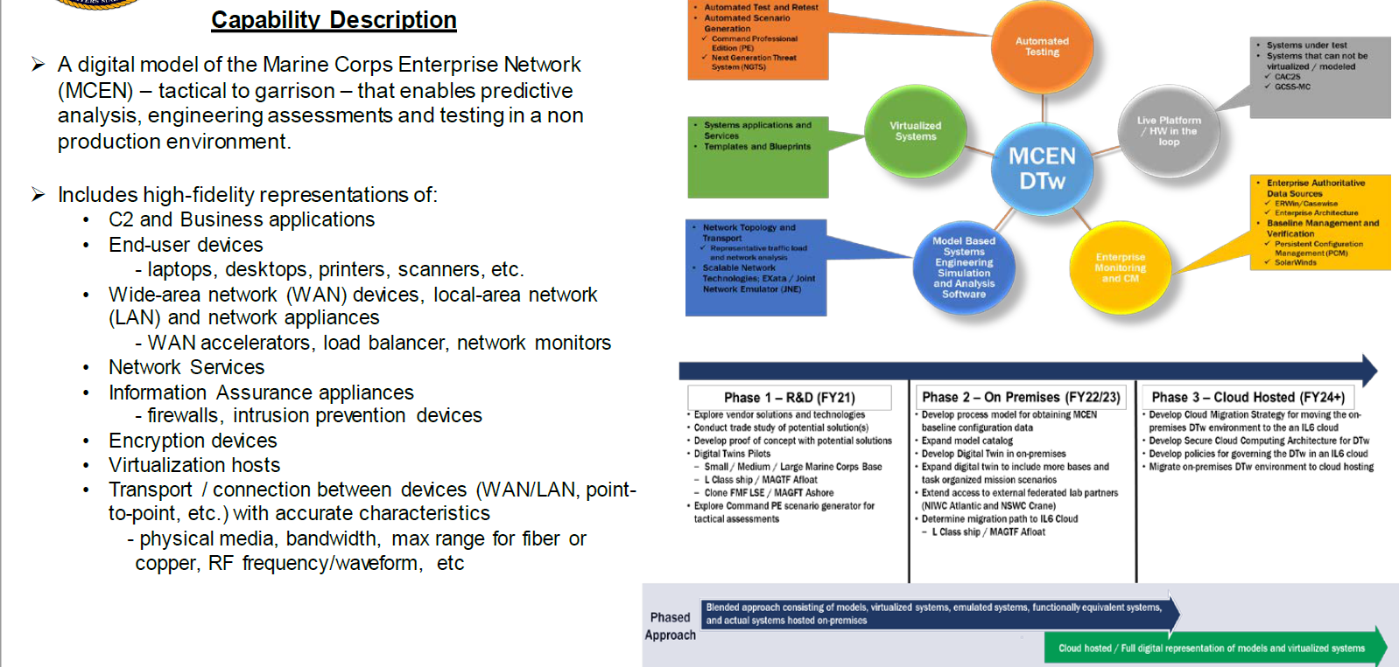
MCEN Digital Twin

Slide 6
Benefits
► Unified engineering effort to:
Provide engineering technical rigor
Evaluate all potential MCEN changes
Conceptualize/design future MCEN
► Configuration Management of the MCEN as a system of systems
► Tactical to Garrison visibility & feasibility
► Automated processes for proposed changes and configuration updates
► TFA documents components and changes to the MCEN

Slide 7
QUESTIONS / DISCUSSION

