Slide 1
Marine Corps Systems Command
IT Contracts updates
May 27, 2021
Ms. Johany M. Deal
Director of Contracts
Marine Corps Systems Command

Slide 2
AFCEA QUANTICO 2021
USMC IT DAY
MCSC IT portfolio Initiatives
Internal Policy Review
  Updating policies to delete redundant reviews
Non-FAR base authorities (OTAs and Commercial Solutions Openings (CSO)– Explore technologies that could lead to prototypes
As of October 1 2020, PfM Supporting Establishment Systems (PfM SES) split under two Navy PEOs (Digital & Enterprise Services (Digital) and Manpower, Logistics & Business Solutions (MLB)).
  New PEOs vision: To realize the vision of digital transformation, optimize program alignment across the Navy & Marine Corps & make IT a “strategic asset”

Slide 3
AFCEA QUANTICO 2021
USMC IT DAY
Cloud Initiatives
The Department of the Navy (DON) Cloud Policy memo of 7 Dec 2020, co-signed by Assistant Secretary of the Navy (Research, Development, and Acquisition) (ASN (RDA)) and DON Chief Information Officer (CIO), provided updated policy for the accelerated promotion, acquisition, and consumption of cloud services in the DON. The DON's Cloud Policy directly supports the DON Information Superiority Vision of 14 Feb 2020, and the Department of Defense CIO's "Interim Guidance for Implementation of Department of Defense Cloud Strategy" memo of 16 April 2020.

Slide 4
AFCEA QUANTICO 2021
USMC IT DAY
Cloud Initiatives (cont.)
The DON CIO Cloud Memo states:
    The DON shall follow a path toward a unified DoD Enterprise Cloud Environment (DECE) in accordance with the DoD Cloud Strategy using DoD approved enterprise cloud solutions, so long as they can support the DON workload & mission owner requirements.
    All cloud computing services in the DON shall be acquired, provisioned & their consumption monitored via the DON's Naval Digital Marketplace https://cloud.navy.mil. The Naval Digital Marketplace shall be managed and maintained by the DON’s Program Executive Office for Digital and Enterprise Services (PEO Digital).
    The DON’s Naval Digital Marketplace will be continuously updated by PEO Digital to provide visibility, awareness & access to all DoD approved cloud contracts which may include, but are not limited to, commercial, Federal, Defense Information Systems Agency (DISA), Air Force & Army cloud contracts, in addition to existing Navy and Marine Corps cloud contracts.

Slide 5
AFCEA QUANTICO 2021
USMC IT DAY
Cloud Initiatives (Cont.)
What does this mean for Contracts?
  New RFPs/RFQs across the USMC for cloud computing services must be submitted through MCSC to PEO Digital for approval prior to release in an effort to:
    Limit duplication
    Maximize enterprise purchasing efficiencies
    Accelerate digital modernization.
  New cloud services cannot be procured as part of a systems integration or contractor support service contract unless they are in support of an existing PEO Digital approved Fit for Purpose Clouds (FPCs).

Slide 6

INFORMATION SYSTEMS PROGRAMS Contracts opportunities

Slide 7
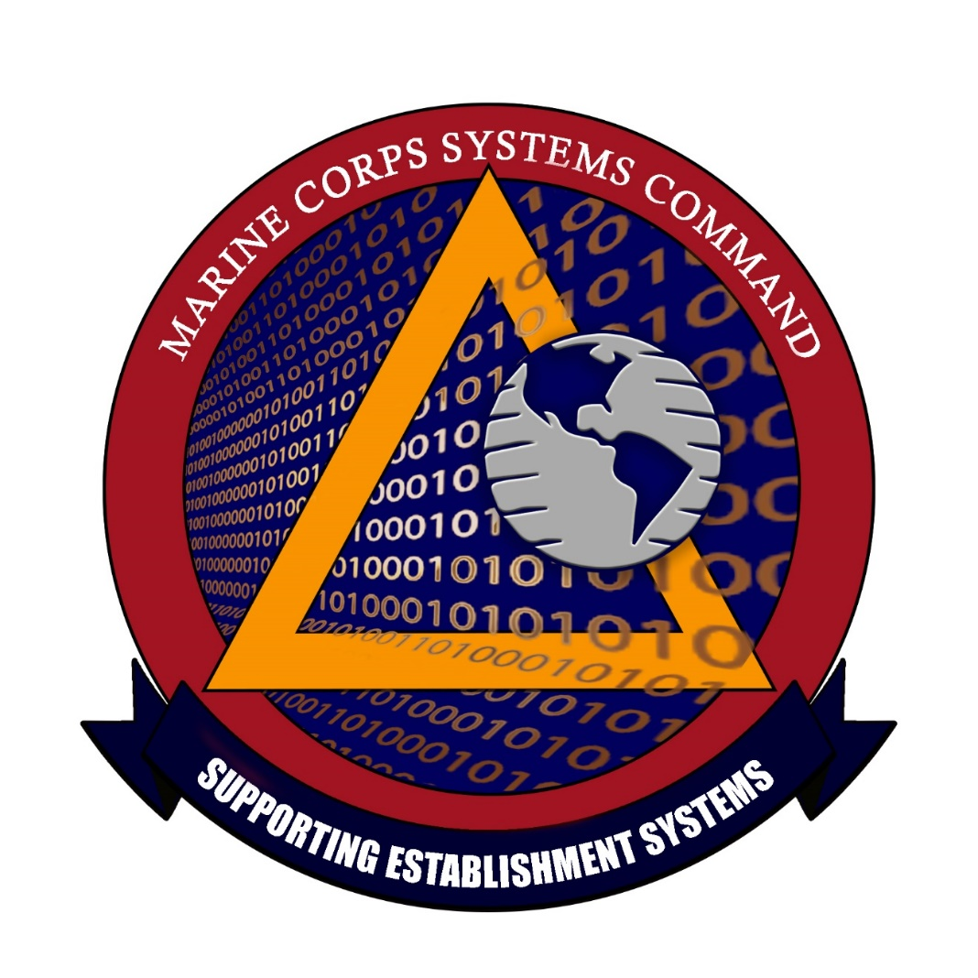

INFORMATION SYSTEMS PROGRAMS –
PEO Digital & PEO MLB
IT Service Management (ITSM) Operation & Sustainment Support
Description/Summary of Program Requirements
The ITSM O&S is a requirement for the development, implementation, and training of additional Information Technology Infrastructure Library (ITIL) processes, maturing current processes, supporting the offline development and training stacks, and establishing a fully automated service request fulfillment capability. The ITSM O&S requirement will also include the migration of legacy network help desks into enterprise Remedy as part of the Legacy Inclusion Project, Maturing Configuration Management Database (CMDB), and Asset Management capabilities. This requirement also includes the migration of enterprise technology refresh, the development of enterprise service mappings to fully populate the CMDB, and enterprise license management. Lastly, the ITSM O&S requirement will support the ITSM Toolset and will mature the regionalized Event Management (EM) system. The USMC requires operational program support, acquisition program management support, and life-cycle sustainment support in order to execute responsibilities for managing the acquisition, fielding, and sustainment of network Information Technology (IT) products, services, and service management.
Acquisition Strategy
RFP: M67854-21-R-4011
Current Contract / Original Developer / OEM (if Recompete)
Contract: M67854-17-F-4419
Milestones
RFQ release: 07 June 2021
Period of Performance
Points of Contact
60 month (12 month base and four 12 month options)
Contracting Officer: Stasia Baker, stasia.baker@usmc.mil
GSA Alliant 2 GWAC competitive
Contractor: AT&T Government Solutions, Inc.
Award: FY21 QTR4
Contract Specialist: Dominique Barr, dominique.barr@usmc.mil
Proposal Due: 07 July 2021

Slide 8
INFORMATION SYSTEMS PROGRAMS –
PEO Digital & PEO MLB
IT Service Management (ITSM) Process Owner Support
Description/Summary of Program Requirements
Acquisition Strategy
RFP#: M67854-21-R-4018
Current Contract / Original Developer / OEM (if Recompete)
Contract: M67854-17-C-4839
Milestones
RFQ release: 7 June 2021
Period of Performance
Points of Contact
60 month (12 month base and four 12 month options)
Contracting Officer: Rich Yungwirth, richard.yungwirth@usmc.mil
Navy SeaPort small business competitive
Contractor: Vintun, LLC
Award: FY21 QTR4
Contract Specialist: Dennis Swafford, dennis.swafford@usmc.mil
Proposal Due: 7 July 2021
The Marine Corps requires support for the development and implementation of common Information Technology (IT) Infrastructure Library (ITIL)-based IT Service Management (ITSM) processes that provide governance for effective delivery of IT services in accordance with the Defense Enterprise Service Management Framework (DESMF).

