Slide 1



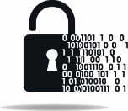

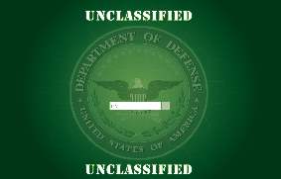











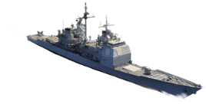

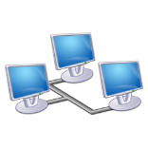



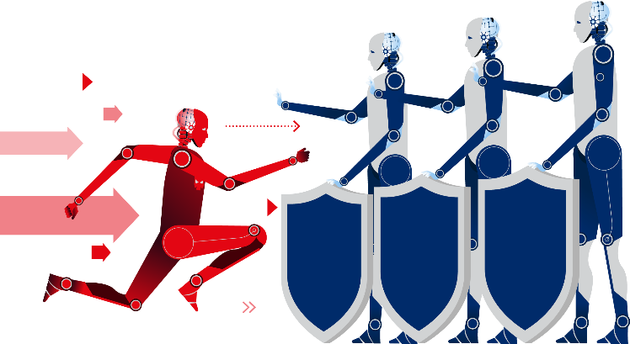
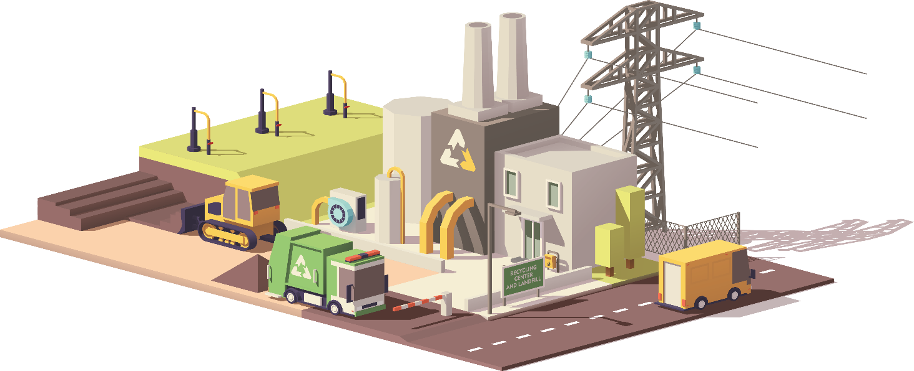
THE CYBER LANDSCAPE
UNCLASSIFIED
NETWORK &
INFO SHARING
CROSS DOMAIN
POSITIONING, NAVIGATION, AND TIMING
End point mgmt:
Perimeter defense
Comply to connect
Continuous monitoring
FIRST
4
ENCRYPTION
NETWORK REMEDIATION
WEAPON SYSTEMS
Identity access mgmt
FIRST
4
DoD
Enterprise
DevSecOps
ENABLERS
FIRST
4
Artificial Intelligence
COMMAND, CONTROL,
AND COMMUNICATIONS
CYBER WORKFORCE
FIRST
4
The Cloud
Mission Partner Networks
CRITICAL INFRASTRUCTURE
HUMAN FACTORS
IT PRODUCT/
SUPPLY CHAIN RISK MGMT
U.S.
Partners
Insider
Threat
Cybersecurity
Culture
Notes:
O:\HDGS\Cyber Policy\PCA\Strategy Implementation\DoD CIO Top 10\Top10Placemat \\ v3

