Slide 1
BGen Crall Director C4
AFCEA Luncheon
3 November 2016
// UNCLASSIFIED //

Slide 2
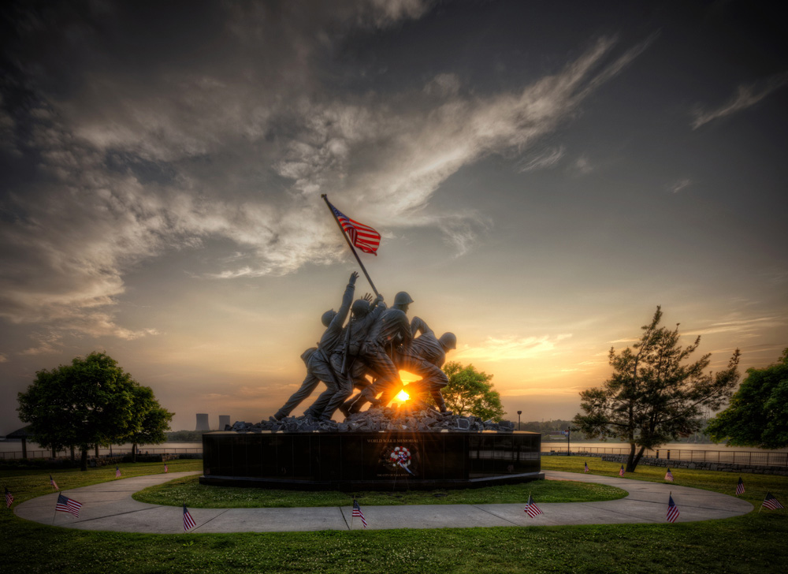
HAPPY BIRTHDAY MARINES

Slide 3
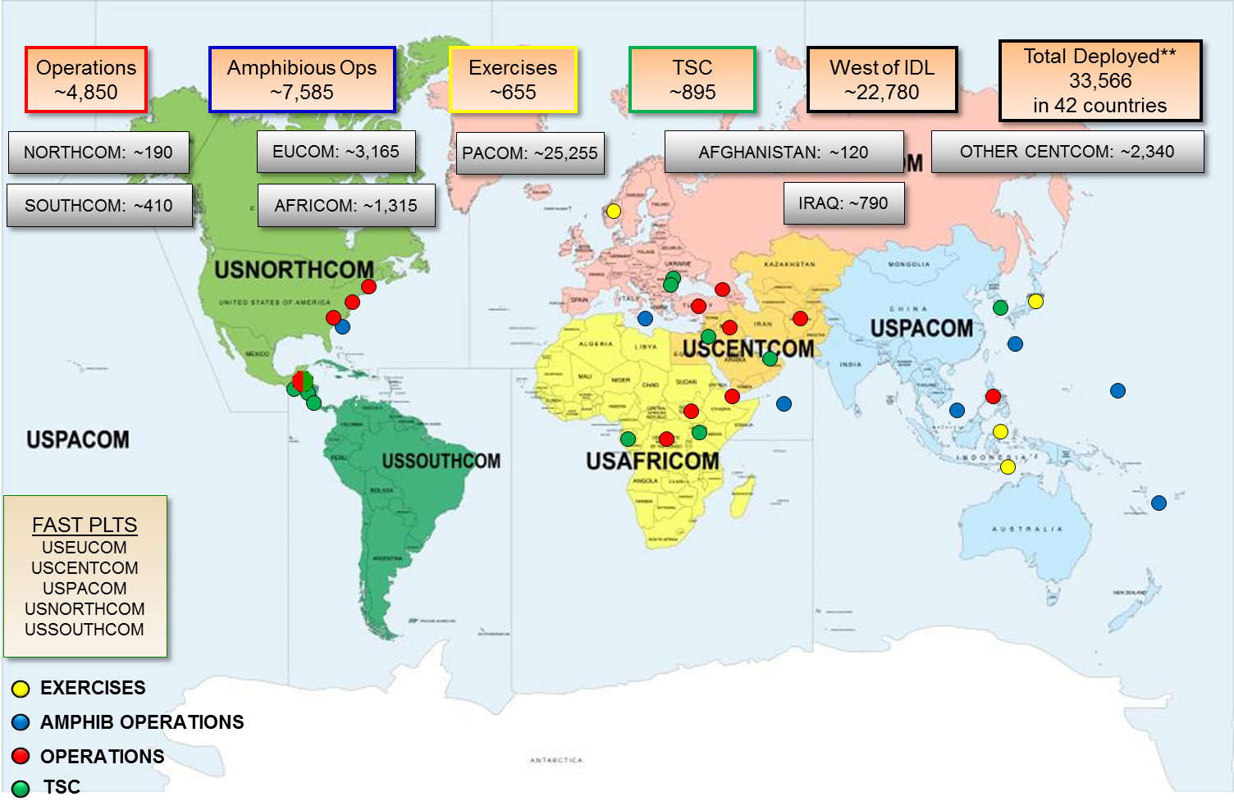
MARINE CORPS TODAY
Five Critical Tasks
Integrate the Naval force to fight at and from the sea
Evolve the MAGTF
Operate with resilience in a contested network environment
Enhance our ability to maneuver
Exploit the competency of the individual Marine

Slide 4
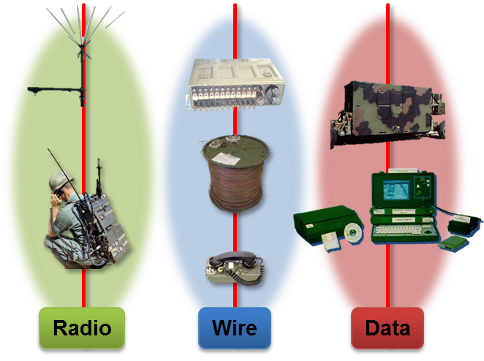
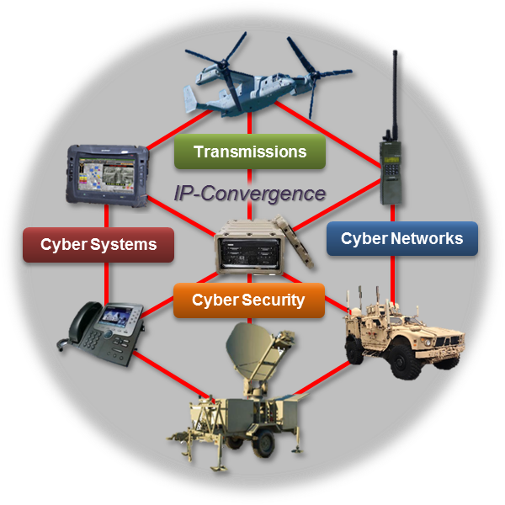
C4 OAG Highlights
“Old Way”
Necessary Shift

Slide 5
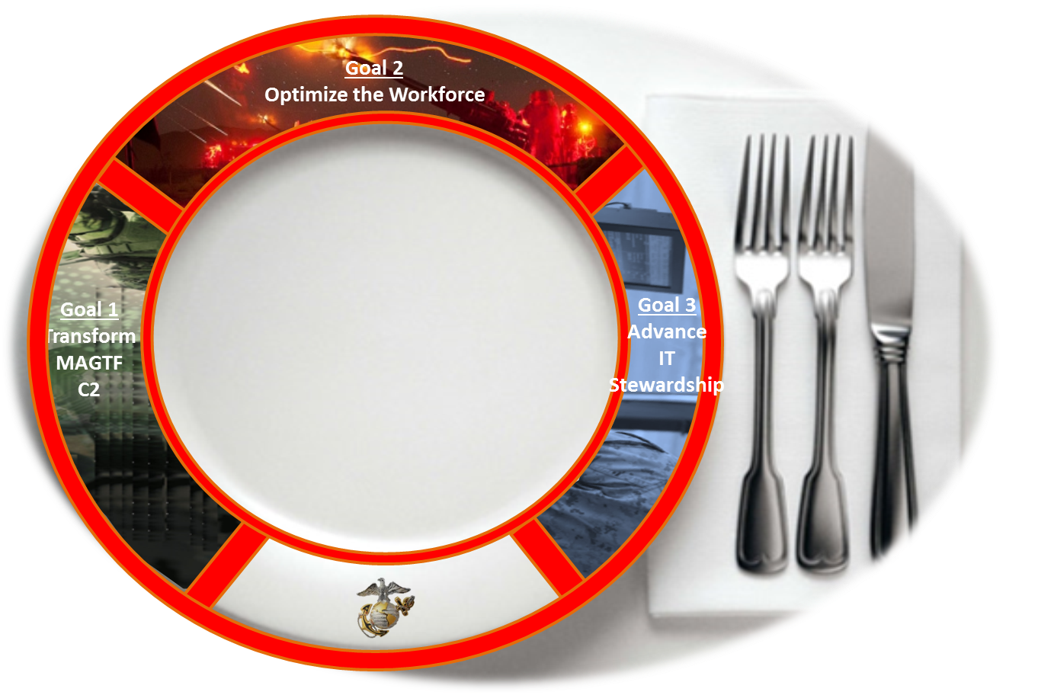
ON MY PLATE…
ZBR
06xx Mod
CTCs
WF Strategy
BYOD
Policy
ITPRAS
Cloud
Get to Green
D-MCEN
PPB&E
IPNS
ITSG
WIN-10
Code-a-Thon
VSAT
Domains

Slide 6
QUESTIONS…

