Slide 1
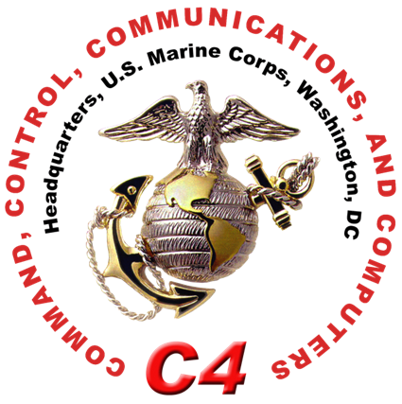
Seamless MCEN AFCEA Luncheon
LtCol Curtis Carlin Strategy Vision Chief, HQMC C4
21 January 2016
// UNCLASSIFIED //

Slide 2
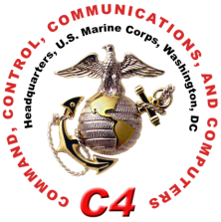
Agenda
Context
Expectations
Seamless Marine Corps Enterprise Network
How Does It Fit
Supporting EF-21
// UNCLASSIFIED //

Slide 3
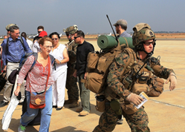
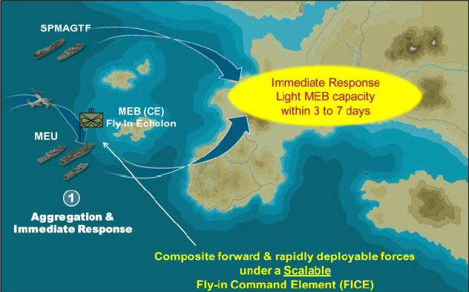
Context
The Marine Corps is within a transition period
Strategic landscape is evolving
Singular Information Environment
Command and Control not adequate in supporting current and envisioned operations
Inability to rapidly deploy forces while maintaining seamless access
Crisis Response
Hours | Days
Marines guide U.S. citizens in Sudan
3 January 2014
Appropriate Point of Engagement
Readiness
Capability
Responsiveness
Capacity
// UNCLASSIFIED //

Slide 4
Expectations
Problem Statement (D-UNS)
The Marine Corps lacks the ability to rapidly deploy forces while maintaining a singular user identity with seamless access to individual and organizational data.
“What it is”
“What it is not”
“Fighting hole to the Flagpole”
Naval Integration
Joint Information Environment
Standardized Applications
Data Center Maturity/Standardization
Common Architecture
Responsive Development
Garrison & Tactical
New Network
Disjointed Permissions
Target Fixation
Non-standardized data centers
Disjointed Architecture
Quick Buy or Quick Fix
// UNCLASSIFIED //

Slide 5
Seamless Marine Corps Enterprise Network
Vision
Ensuring seamless and persistent Information Environment access enabling C2 Agility from the “Fighting hole to the Flagpole.”
// UNCLASSIFIED //

Slide 6
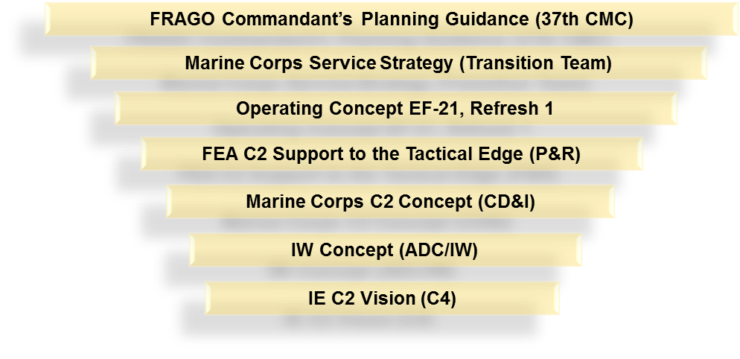
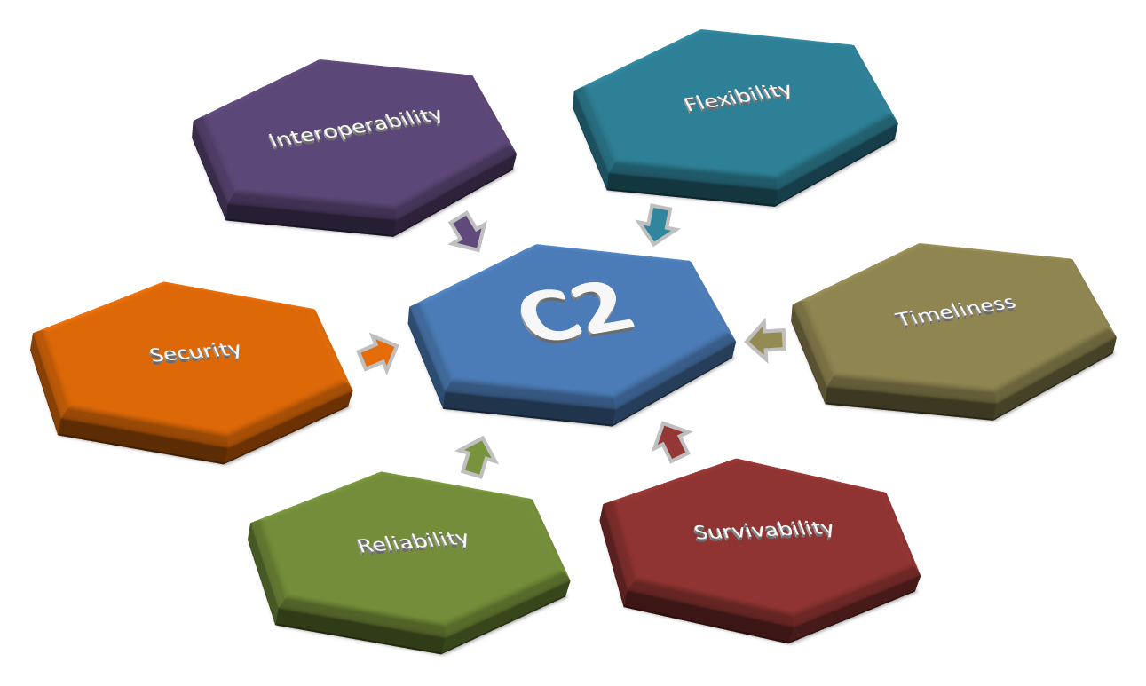
How does it fit
~ Chapt-1:The Future is Now ~
~ Chapt-1:The Future is Now ~
“Mission tactics is an imperative on the battlefield where we assume the enemy will seek to compromise or degrade our ability to communicate”
“Ensuring Mission Command Elements through the empowerment of agile and adaptive leaders to seamlessly leverage all aspects of the Information Environment”
1
2
// UNCLASSIFIED //

Slide 7
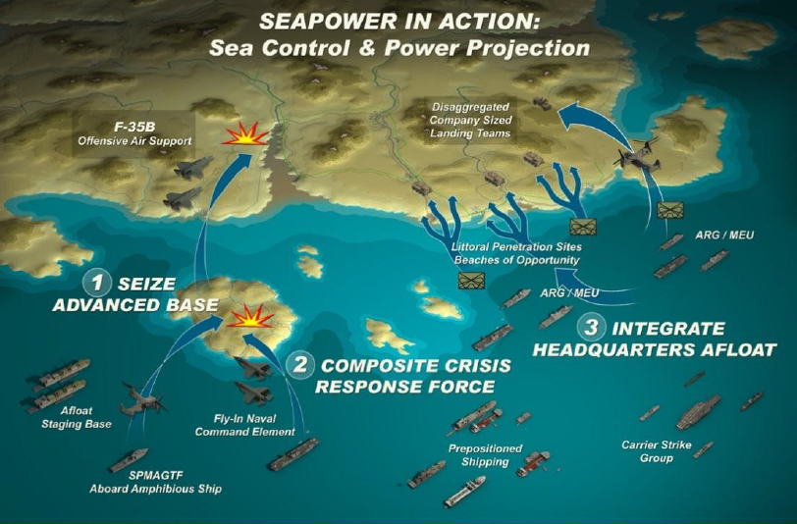
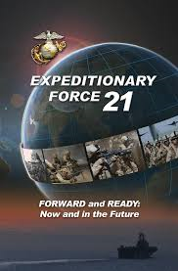
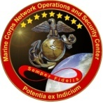
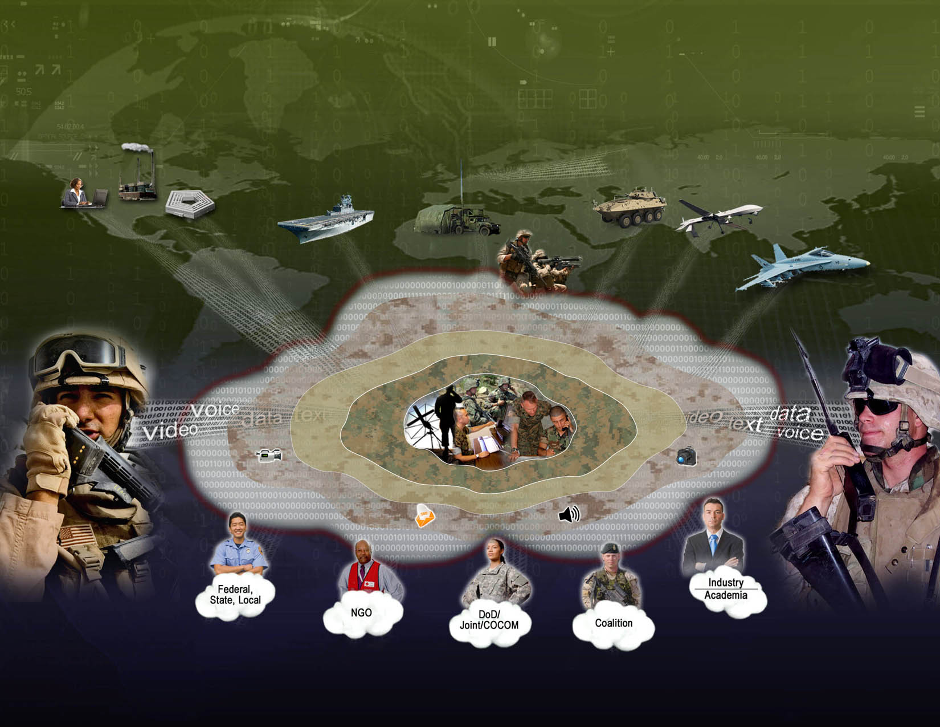
Supporting EF-21
Seamless MCEN
Standardization
“Fighting Hole to Flagpole”
MCEN Regionalization
Optimization
Korea
MITSC
WEST-PAC
MITSC
HQMC
Camp Fuji
HQMC
Okinawa
8th & I
Henderson Hall
Kansas City
Iwakuni
MITSC
NCR
MCB Quantico
Bridgeport
MCAF Quantico
29 Palms
Norfolk
MCB
Pendleton
Cherry Point
MCB Lejeune
Parris Island
MCRD San Diego
MCAS Beaufort
MCAS Miramar
Albany
MITSC
EAST
Barstow
Blount Island
MCAS Yuma
MITSC
RES
New
Orleans
Camp
Smith
Kaneohe
Bay
MITSC
MID-PAC
MITSC
WEST
Panzer
Kaserne
MITSC
EUR
CRISIS RESPONSE JOINT FORCEABLE ENTRY
HOURS to DAYS
Mobility – Deploy the MCEN – Access at the Point of Need
Base/Post/Station Infrastructure Capabilities
Enterprise Cloud
Tactical Cloudlet
MOS Modernization
Virtualization
Standard Gateway
Dynamic Routing
Network Foraging
Spectrum Agility
Single sign-on/identity
Readiness
Capability
Responsiveness
// UNCLASSIFIED //
Capacity

Slide 8
Enabling EF-21 through C2 Agility
Seamless MCEN
Standardization
Optimization
Korea
MITSC
WEST-PAC
MITSC
HQMC
Camp Fuji
HQMC
Okinawa
8th & I
Henderson Hall
Iwakuni
Kansas City
MCB Quantico
MITSC
NCR
Bridgeport
MCAF Quantico
29 Palms
Norfolk
MCB
Pendleton
Cherry Point
MCB Lejeune
MCRD San Diego
Parris Island
MCAS Miramar
MCAS Beaufort
Barstow
Albany
MITSC
EAST
Camp
Smith
MCAS Yuma
MITSC
RES
New
Orleans
Blount Island
Kaneohe
Bay
MITSC
WEST
MITSC
MID-PAC
Panzer
Kaserne
MITSC
EUR
CRISIS RESPONSE JOINT FORCEABLE ENTRY
HOURS to DAYS
“Fighting Hole to Flagpole”
Readiness
Capability
Responsiveness
// UNCLASSIFIED //
Capacity

Slide 9
Questions
// UNCLASSIFIED //

