Slide 1

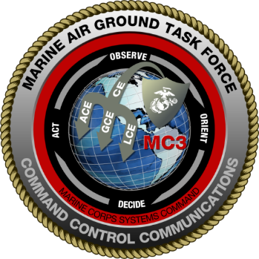
MC3 Overview
AFCEA
USMC IT DAY
April 28, 2015
Marine Corps Systems Command
MAGTF COMMAND, CONTROL, COMMUNICATIONS
PM MC3
DISTRIBUTION A. Approved for public release: distribution unlimited.

Slide 2
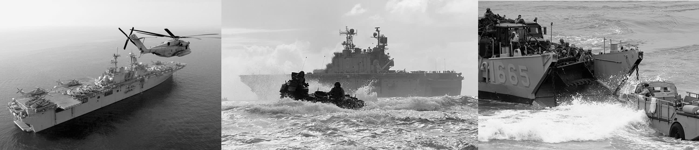
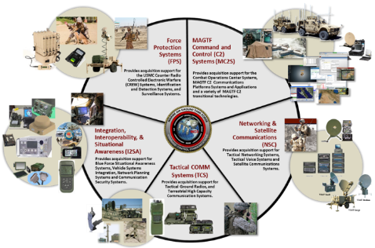
Agenda
PM MC3 Overview
  PdM Networking and Satellite Communications – PdM NSC
PdM Tactical Communication Systems – PdM TCS
PdM Integration, Interoperability, and Situational Awareness – PdM I2SA
PdM MAGTF Command and Control (C2) Systems – PdM MC2S
Science and Technology Efforts – MC3 Advanced Technology Integrator
Questions

Slide 3
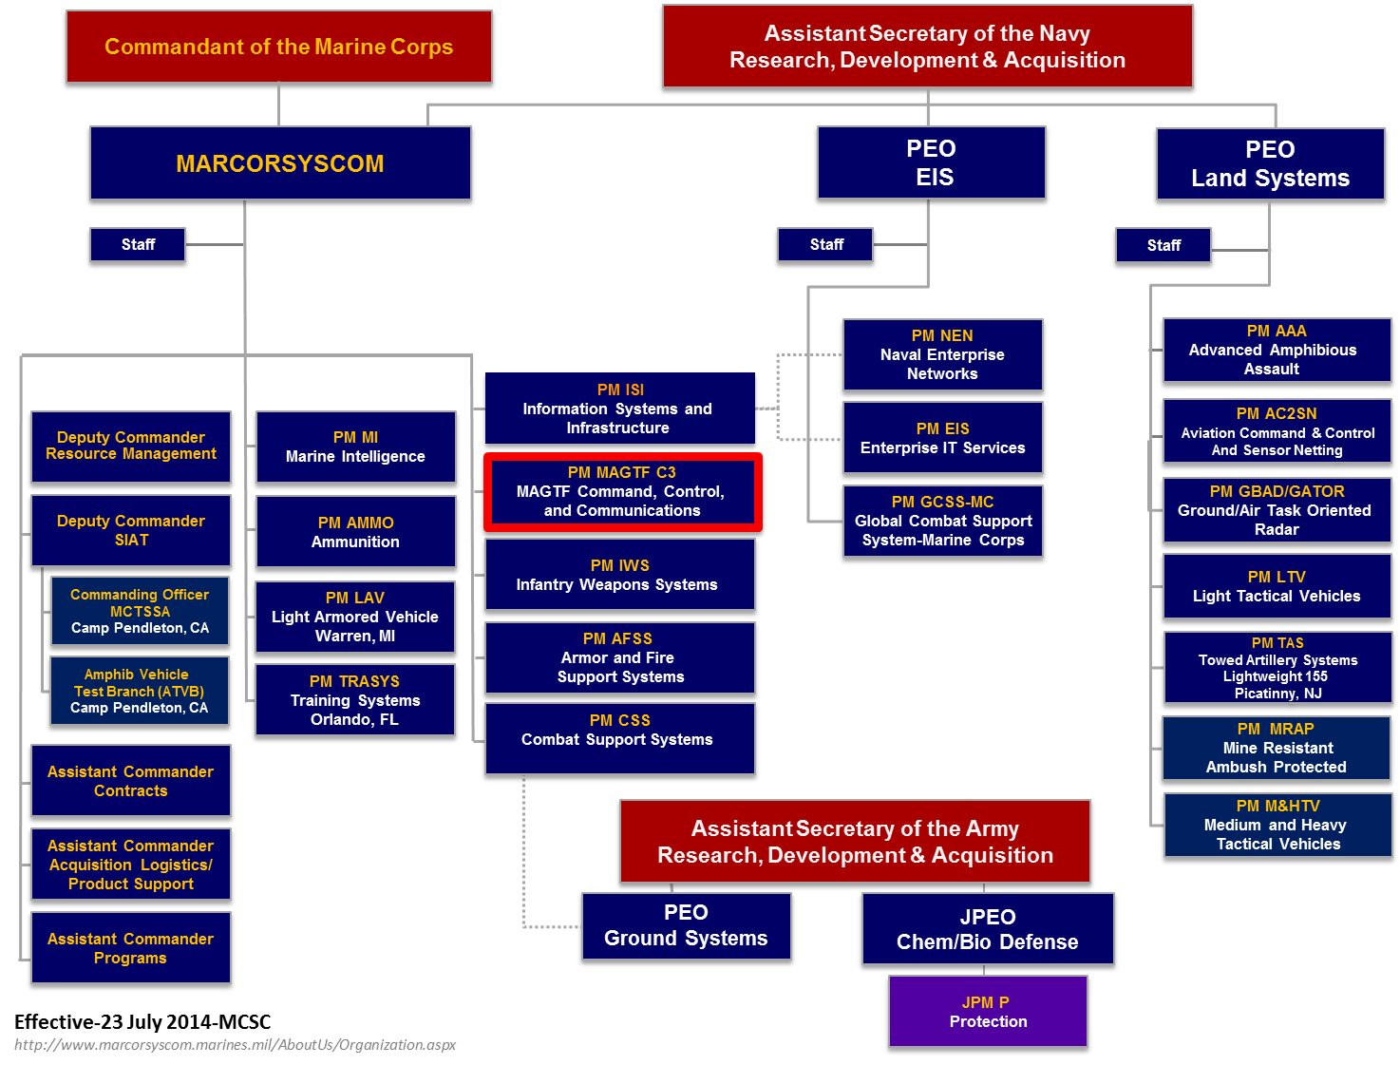
Marine Corps Systems Command Organization

Slide 4
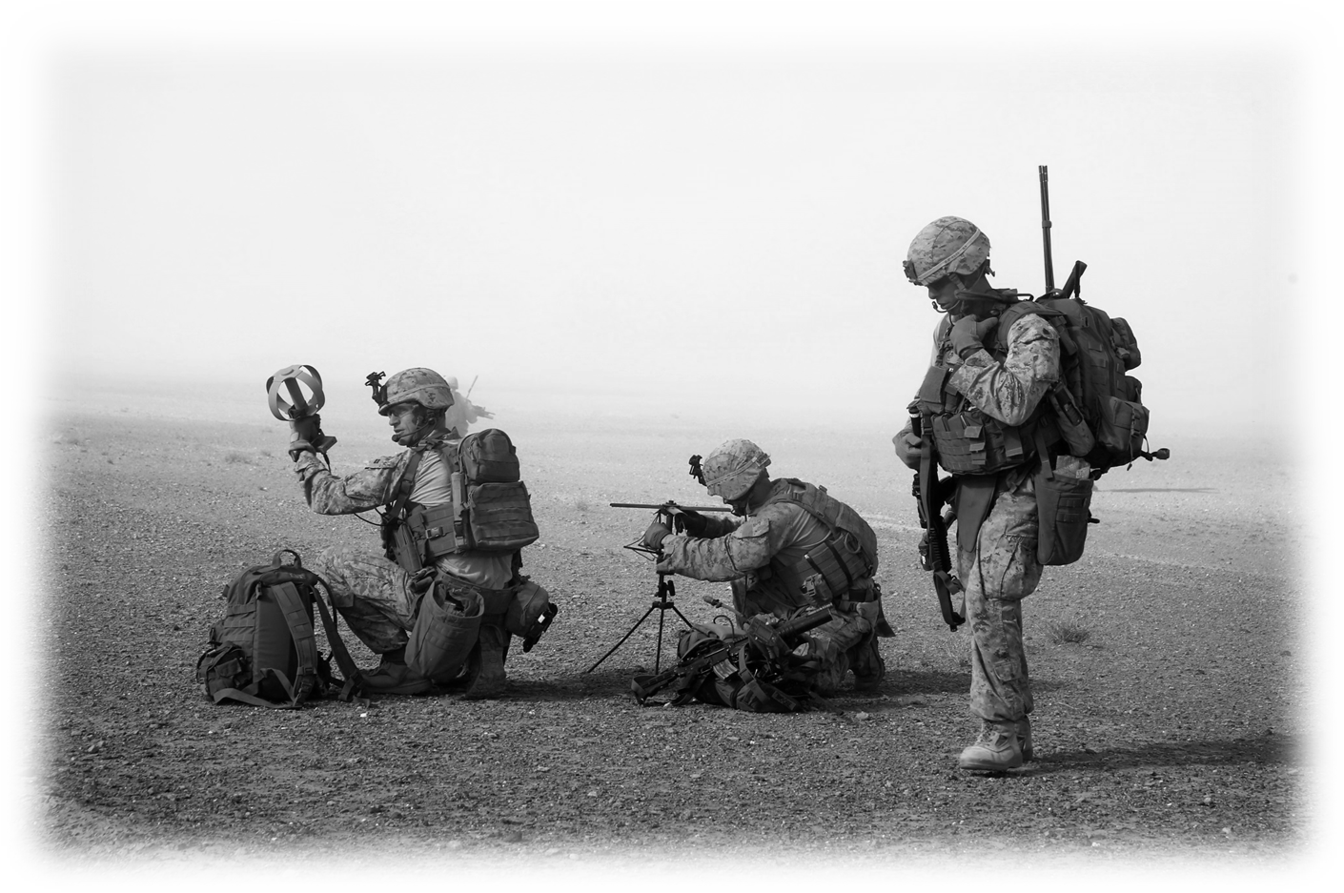
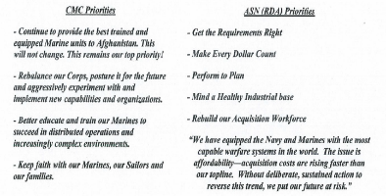
Marine Corps Guidance
36th Commandants Message
MCSC Mission
MCSC Commander’s Intent
MC3 Priorities
Readiness: Maintaining a first-rate, well-trained total force of Marines in a high state of readiness.
Priority Support: Prioritizing the support of those Marines in harm's way.
Expeditionary Force: Developing and fielding MAGTF capabilities that will ensure that the Marine Corps remains an innovative, relevant, naval, expeditionary force-in-readiness.
Family Readiness: Building upon our success in leader development, professional military education, wounded warrior care, and family readiness.
To serve as the Department of the Navy’s (DON) systems command for Marine Corps ground weapon and information technology (IT) system programs in order to equip and sustain Marine forces with full-spectrum, current and future expeditionary and crisis response capabilities.
Align MCSC Priorities with Commandant’s and ASN RDA’s Priorities
Work Environment
Executing to the Plan
Professional Credibility
Preparing for the future
MC3 Enduring priorities: accomplish the mission, take care of each other; represent our command, corps, and country honorably.

Slide 5
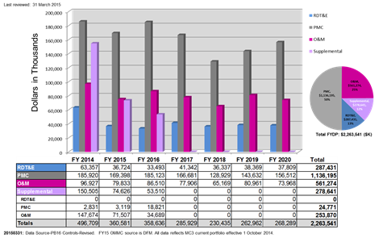
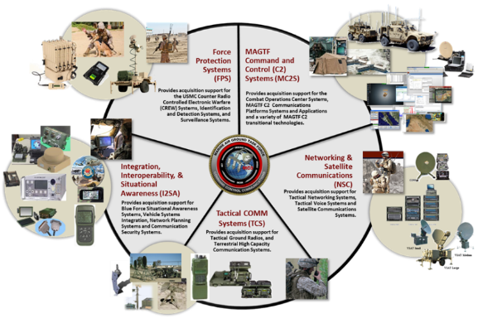
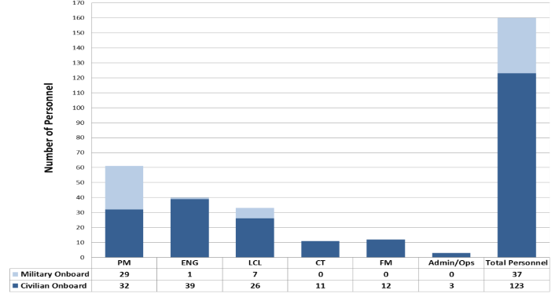
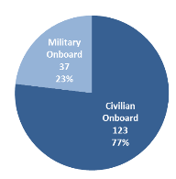
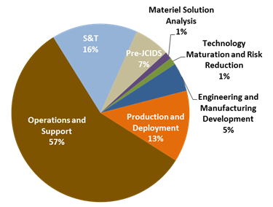
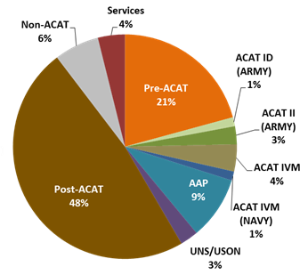
Portfolio Overview PMM-111 (MC3)
Provide and sustain command and control capabilities to the MAGTF.
Budget Profile
Total Personnel-160
Efforts by Phase
Efforts by ACAT
Total Number of
MC3 Portfolio Efforts =76

Slide 6
PMM-111 (MC3) Organization
Total Efforts: 76
FY 14-20 Funding: $2.3B
Program Manager
Deputy PM
APMs
Ops/Admin
PMO Staff
MC3 Science &Technology
(S&T)
Force Protection Systems
(FPS)
Integration, Interoperability and Situational Awareness
(I2SA)
MAGTF C2 Systems
(MC2S)
Networking and SATCOM
(NSC)
Tactical COMM Systems
(TCS)
Antenna Electrocution (TCS)
BMDL (COC)
DTN (NOTM)
EAITE (COC)
H2C2 (I2SA)
ICS (NOTM)
ISR C2Sync (TSOA)
Mobility JCTD (I2SA)
Object Video (GBOSS/No Funding)
RAP (I2SA)
SCC (NOTM)
TEDS / TIES (COC)
USMC CREW
CVRJ (V)1 (II)
CVRJ (V)2 (IV-M)
MEU Phase 1 (USON)
MEU Phase 2 (ACAT IVM) Thor III (IVM)
I&D
BAT/HIIDE (UUNS)
BESD (AAP)
CSBS (Non-ACAT)
EFEC (USON)
IDD
IDS-MC (AAP)
RMNIIS (Non-ACAT)
Secure 1000
SS
GBOSS (IVM)
JBC-P FoS
JBC-P Incr 1 (ID-A)
JBC-P Incr 2 (II-A)
Handhelds (Services)
EXCOMM
COMSEC (Services)
DAGR (II-AF)
NPM SPEED
VSI
VSI Systems (Services)
COC
COC (V) 2-4 (III)
COC (V) 1 (AAP)
MC2SA
JTCW (IVT)
TCO-GCCS (IVT)
TSOA (ACAT IV M)
EMC2
NOTM
NOTM (IV M)
NOTM AAO Increase (Pre-ACAT)
NOTM-A (USON)
NOTM-ITV (USON)
HMSAS (AAP)
TACNET
DDS-M (IVM)
DTC-R (IVM)
JCSE (Non-ACAT)
JECCS (IVM)
TVSS (IVM)
TVSS VoIP (AAP)
SATCOM
ECCS (IVM)
GBS (IC-JPO)
LMST (IVT)
Phoenix TS (III-A)
SMART-T (II-A)
SMART-T AEHF Upgrade
SWAN/VSAT (IVM)
SCI Comms FoS (AAP)
SCI VSAT/HBSI-TT(AAP)
SCI COMMS/ HBSI-PT (AAP)
GR
EPLRS (II-A)
HFR (IVM)
IISR (IVM)
THHR (IVM)
THHR Maritime (V) 3 (AAP)
THHR SVA (IVM)
MBR (Non-ACAT)
MBR II (ACAT IVM)
MUOS (ECP)
SINCGARS (II-A)
THC2
WPPL-D (USON)
AN/TRC-170 A (II-AF)
NGT (Pre-ACAT)
MRC-142 B (AAP)
MRC-142 C (IVM)
TEAMS (AAP)
TSSR (USON)
TWTS Portfolio (Pre-ACAT)
Last Reviewed: 22 April 2015

Slide 7
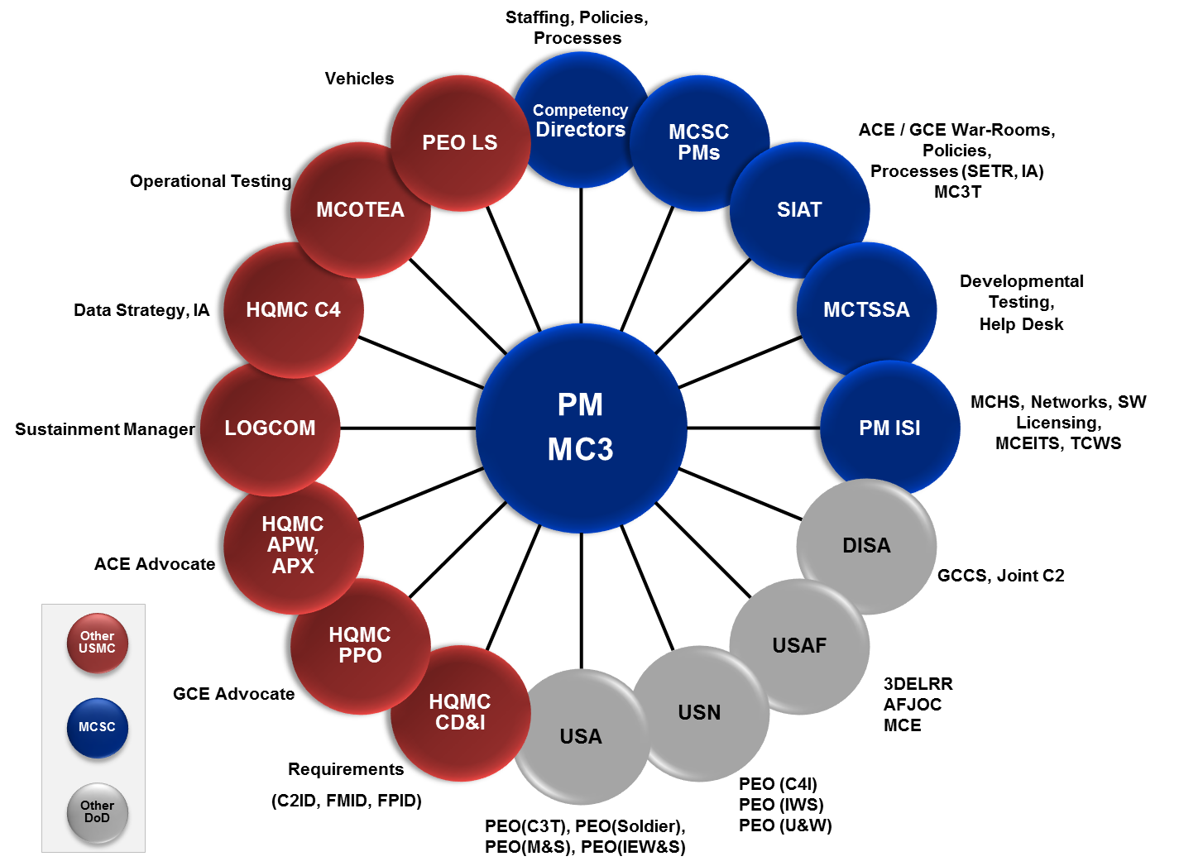
MC3 Major Stakeholders

Slide 8

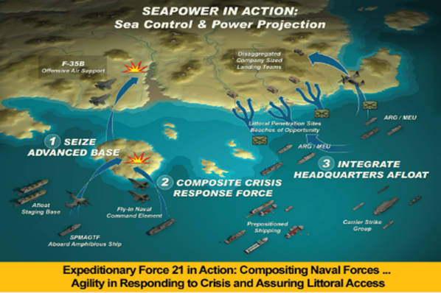
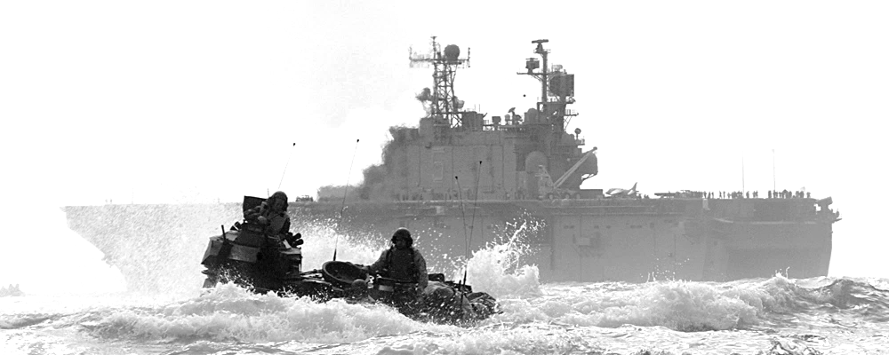
Expeditionary Force 21
Brigade-level organizations with a specific regional focus.
Built for austere environments.
Light and modular force able to get to the scene of action quickly, yet capable enough to accomplish the mission or provide a stopgap.
An increased forward presence around the globe.
Modular forces that are rapidly scalable to respond to escalating crises.
A more integrated naval force better able to prosecute complex combat operations.
Establishes C2 and employment options for scalable units.
“Through Expeditionary Force 21 we will chart a course over the next 10 years to field a Marine Corps that will be: the right force in the right place at the right time.”
Notes:
Expeditionary Force 21 Attributes
Expeditionary Force In “Readiness”
- 1/3 of operating forces deployed forward for deterrence
and proximity to crises
- Self-sustaining under austere conditions
Middleweight Force
- Light enough for rapid response
- Heavy enough to prevail in the littorals
Modern Force
- Preserves quantitative edge over opponents
- Exploits innovative concepts and approaches
Integrated Combined Arms Force
- Applies all aspects of joint combat power
- Extends power of naval forces
Integrated Naval Force
- Command and control exploits the sea as maneuver space
- Leverages traditional and innovative operating concepts
Force Biased for Action
- Poised for rapid crisis response – no tiered readiness
Readily Deployable-Employable-Sustainable forces
Leading Edge of Joint Force
- Regionally oriented MEFs and MEBs
- Small fly-in command element capable of
transitioning to a joint warfighting headquarters
Forcible Entry In Depth
- Scalable to crisis, contingency or forcible entry
- Capable of projecting two MEBs from the sea
- Seizes and holds for follow-on joint forces

Slide 9
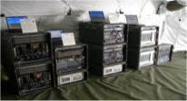
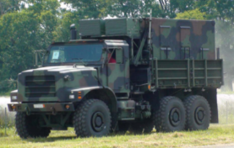
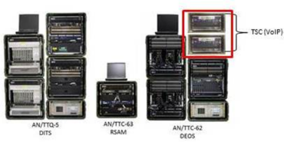
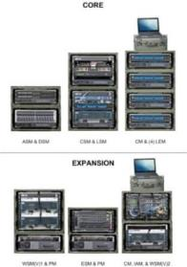
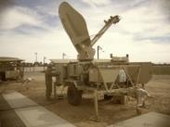
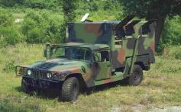
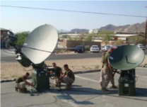
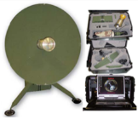
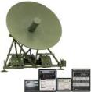
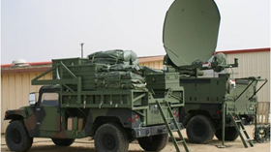
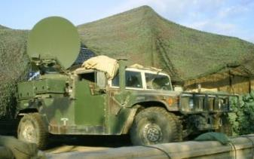
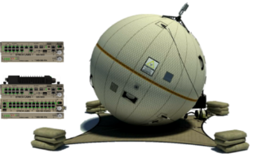
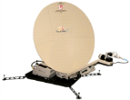
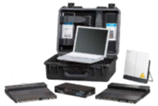
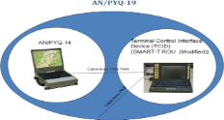
Networking And Satellite Communications (PdM NSC)
DTC-R
PdM NSC MISSION
PdM NSC leads the Marine Corps’ effort in research and development, acquisition and sustainment of tactical networking and switching equipment; wireless broadband, and satellite ground communication systems.
Tactical Network Systems
Digital Technical Control (DTC) - Refresh
Tactical networking, tactical switching, and technical control functions to our Operating Forces. Systems being developed and sustained include TDN DDS-M, DTC-R, TVSS, TVSS VoIP, and JECCS.
Tactical Data Network Data Distribution System - Modular
DDS-M
VSAT
Very Small Aperture Terminal
JECCS
VSAT Large
TVSS VoIP
Tactical Voice Switching System
Joint Enhanced Core Communications Systems
Satellite Communication Systems
EHF and SHF wideband SATCOM systems providing long-haul communications to higher headquarters for reach back into the GIG and intra-MAGTF communications down to the Battalion level. Systems include VSAT, ECCS, LMST, Phoenix, SMART-T, GBS, and HBSI-PT.
LMST/Phoenix
SMART-T
HBSI-PT
High Bandwidth Special Intelligence-Palletized Terminal
GBS
Global Broadcast Service
Lightweight Multi-Band Satellite Terminal
Secure Mobile Anti-Jam Reliable Tactical Terminal
VSAT Medium
VSAT Small
ECCS
Expeditionary Command & Control Suite

Slide 10
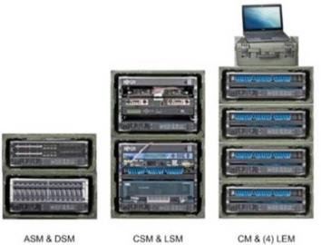
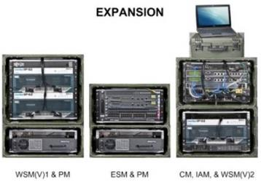

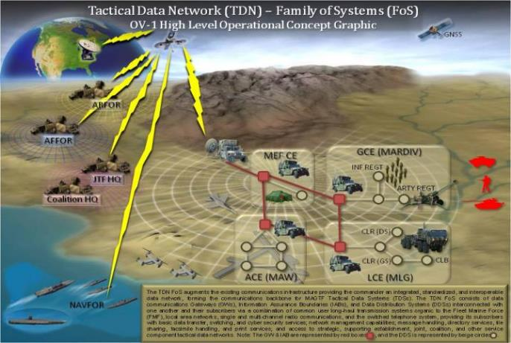
Tactical Data Network Data Distribution System – Modular (TDN DDS-M)
The DDS-M is the fourth generation product within the TDN family of systems, replacing all preceding legacy systems. The TDN DDS-M provides the backbone data communications infrastructure to the MAGTF Commander in the form of a modular integrated data network.
The DDS-M is an integrated data network providing the capability to:
  Send and receive email
  Share files and storage
  Authenticate users and equipment
  Perform required IA functions
  Internet Protocol Video Telephone Conference access and transport
  Transparent routing and switching of digital messages between the Local Area Network (LAN), circuit switch, and Voice over Internet Protocol access and transport
Provides a Internet Service Provider (ISP) like capability for the operating forces tactical network.
Enables reduction of network package resources from transmission systems.
Provides a modular scalable solution to the commander facilitating a "bring what the mission required" philosophy.
Embraces virtualization which facilitates a N:1 ratio of virtual to physical servers.
Provides a Session Border Controller (SBC) and replacement to the Deployed Interdiction Security Device (DSID) and Deployed Information Assurance Tool Suite (DIATS).
Fielding Core Modules: Full Operational Capability (FOC) 2nd Qtr FY15.
Fielding Expansion Modules: FOC 2nd Qtr FY15.

Slide 11
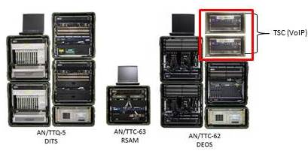
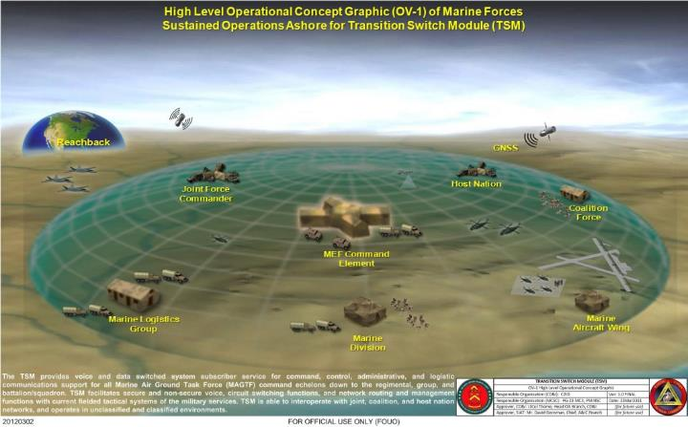
Tactical Voice Switching System (TVSS)
Voice Over Internet Protocol (VoIP)
TVSS:
The TVSS family of systems support fast-paced, flexible, and distributed operations by providing commanders with mission critical voice connectivity up to Secret/Coalition Secret level. The TVSS is a modular ISDN circuit switch capable system that provides secure telephone/switching capabilities, combines multiplexing, transmission encryption, group modem, and UPS capabilities in one system. TVSS consists of three functional suites: DITS, DEOS, and RSAM.
VoIP:
The VoIP program consists of two Tactical Session Controllers (TSCs) that provide Unified Capabilities (UC) compliant Voice over Internet Protocol (VoIP) services into the existing DEOS to support mission requirements migrating away from legacy TDM. The TSCs are capable of providing secure and non-secure VoIP communications.
VoIP, a component of the DEOS, adds an additional two transit cases (i.e. TSCs) to compliment the DEOS suite.
TVSS:
Fielded ECP 8 Modifications (i.e. Windows 7).
Integration of VoIP capabilities.
Fielding of VoIP (3rdQtrFY15 through 2ndQtrFY16).
Relieved of requirements to sustain DITS, DEOS, and RSAM NLT FY18.
Disposal for DITS beginning 4thQtrFY15, DEOS/RSAM beginning 2ndQtrFY17.
VoIP:
Abbreviated Acquisition Program (AAP) designation - 09 May 2014.
Received Full Rate Production (FRP) - Jan 2015.
Fielding of VoIP planned 3rdQtrFY15 through 2ndQtrFY16.
New requirement for VoIP Server Solution expected 3rdQtrFY18.

Slide 12
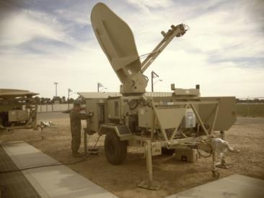
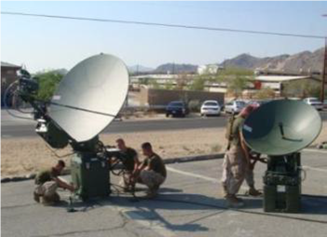
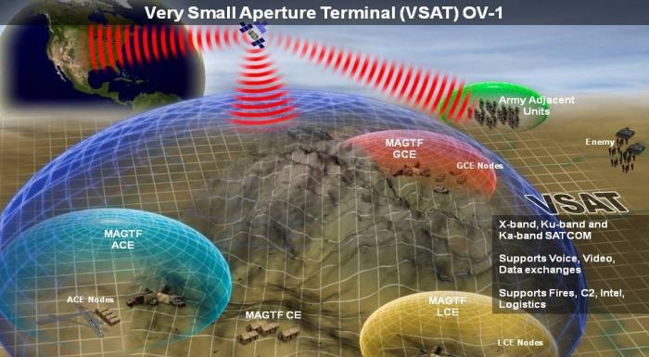
Very Small Aperture Terminal (VSAT)
The Very Small Aperture Terminal (VSAT) Family of Systems (FoS) is a scalable SATCOM capability that provides in-theater communications links, as well as reach-back into DoD Gateways:
Simultaneous Unclassified (NIPRNET) and Classified Data (SIPRNET).
Unclassified and Secure Voice/Voice over Internet Protocol (VoIP).
Unclassified and Secure Video to Marine Air-Ground Task Force (MAGTF) Commanders.
Supports hub-spoke, full mesh and hybrid network topologies utilizing Frequency-Division Multiple-Access (FDMA) and Time-Division Multiple-Access (TDMA) techniques.
VSAT Large
VSAT Medium
VSAT Small
VSAT-Large
  Provides reach-back and in-theater connectivity between MSCs and higher headquarters via commercial Ku-band and military Ka-band SATCOM.
  Fully interoperable with DISA and US Army systems.
  Target platform to subsume capabilities currently provided by Phoenix and Lightweight Multiband Satellite Terminal (LMST) beginning FY15.
  Military X-band upgrade planned for FY15.
VSAT-Small/Medium
  Provides connectivity to MEUs, MSCs, and lower echelons via commercial Ku-band SATCOM.
  Military Ka-band upgrades planned for FY15.

Slide 13
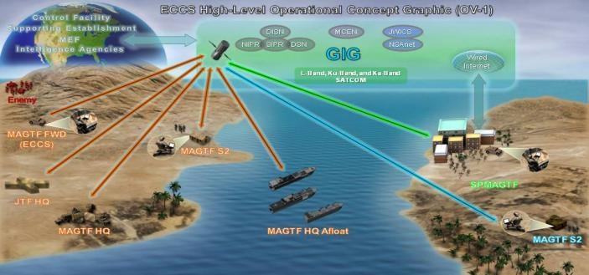
Expeditionary Command and Control Suite (ECCS)
  ECCS is a quick-reaction first-in SATCOM capability for dispersed and distributed operations. ECCS supports a diverse community of users by providing access to multiple security enclaves simultaneously up to TS/SCI.
  The ECCS Rapid Response Kit (RRK) provides access via SATCOM or public Internet Service Provider (ISP) to NIPR and SIPR services on the Marine Corps Enterprise Network (MCEN). Connectivity to the MCEN is enabled by three Consolidated Base Stations (CBS), co-located with MAGTF IT Support Centers (MITSC). The RRK is interoperable with DoD Teleport/Gateways and commercial ISPs.
  The ECCS Sensitive Compartmented Information Kit (SCIK) provides access via SATCOM to SCI Voice and Data Networks (e.g., Joint Worldwide Intelligence communications Service[JWICS], National Security Agency [NSA] Network, and National Secure Telephony Service [NSTS]). The SCIK is interoperable with DoD Teleport/Gateways.
    Leverages Navy-led Deployable Joint Command and Control (DJC2) program.
    Provides a lightweight deployable SATCOM capability with small logistical footprint (advance party “first-in” operations / Humanitarian assistance).
    Memorandum of Agreement (MOA) established between PM MC3 and PMW 790 leverages the DJC2 Program Office and the Naval Surface Warfare Center (NSWC) Panama City Division (PCD) for test and evaluation, contracting, development of Consolidated Base Stations (CBS), and sustainment efforts.
    FY 13 Block 0 capability provides RRKs and SCIKs at MEFs to provide DISN and SCI Network services to tactical units.
      FY 14 Block 1 capability adds CBSs at MITSC installations to provide access to the MCEN for DISN services.

Slide 14
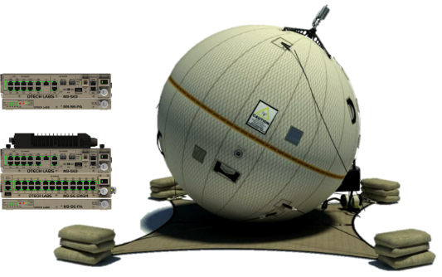
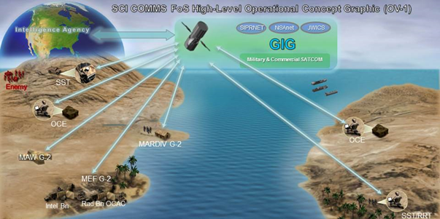
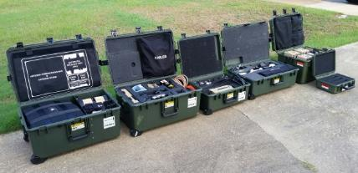
High Bandwidth Special Intelligence-Portable Terminal (HBSI-PT)
The SCI COMMS HBSI-PT system supports fast-paced, flexible, and distributed operations by providing commanders with mission critical voice and data connectivity at up to Top Secret/Sensitive Compartmented Information level. HBSI-PT is a palletized system that enables global access to tactical, theater, and national intelligence data stores facilitating functions, which include tasking, reporting, and dissemination by elements ranging from Ground Combat Elements to a Marine Expeditionary Force Command Element.
The HBSI-PT system is a SATCOM terminal with a 2.4m antenna and associated IP based networking equipment that operates in Ku and X-band.
HBSI-PT reduces cost, weight, and footprint while increasing capability; meeting operating forces demands for a smaller, lighter, palletized solution.
  Transported in 6 transit cases with a total weight of 359lbs (The previous material solution, Trojan SPIRIT LITE (v)1, comprised of 17-22 transit cases for a total weight of 2200 lbs) for a total reduction of 11-16 transit cases and 1841 lbs.
Leverages Army PM WIN-T GATR SBIR Phase III procurement contract.
Received Abbreviated Acquisition Program (AAP) designation - 09 May 2014.
Received Full Rate Production (FRP) Oct 2014.
Fielding planned 4thQtrFY15 through 3rdQtrFY16.

Slide 15
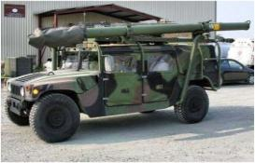
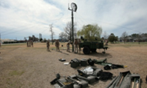
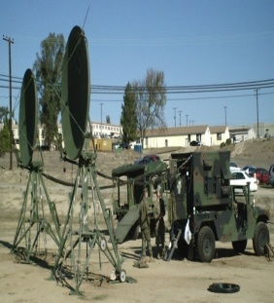


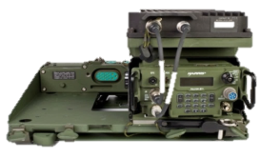
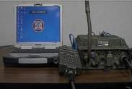
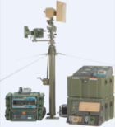
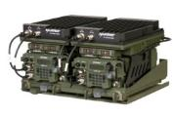

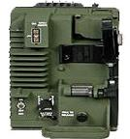









Tactical Communication Systems (PdM TCS)
PdM TCS MISSION
PdM TCS leads the Marine Corps’ tactical communication modernization effort through the acquisition and life cycle management of tactical communication systems supporting combat and training operations.
Terrestrial High Capacity Communications
Line-of-Sight (LOS) and Beyond LOS voice and data tactical radio capabilities.
AN/MRC-142 FoS
AN/TRC-170A
AN/MRC-142 Radio Termination Set
Troposcatter Microwave Radio Terminal System
TEAMS
Tactical Elevated Antenna Mast System
MBR/MBR II
TSSR
Multi-Band Radio II
EPLRS
Troposcatter Satellite Support Radio
Enhanced Position Location Reporting System-ENM (Network Manager)
AN/PRC-117G
AN/VRC-114(V)1
  AN/VRC-112
  AN/VRC-113
WPPL-D
AN/VRC-114(V)2
Ground Radios
Multiband Line-of-Sight and Satellite man-packable and vehicular mounted capabilities and Tactical Hand Held Radios (THHR), line-of-Sight handheld and vehicular mounted capabilities supporting the United States Marine Corps.
Wireless Point-to-Point Link
IISR
NGT
Integrated Intra-Squad Radio
Next Generation Troposcatter
THHR
Tactical Hand-Held Radio
THHR-Maritime
THHR-SVA
HFR
Tactical Hand-Held Radio Single Vehicle Adapter
High Frequency Radio
Current System AN/TRC-170

Slide 16





Multi-Band Radio MBR II (FoS)
MBR II consists of tactical, vehicle and man-pack radios that provide secure, multiband communications in the 30 MHz-2 GHz frequency spectrum, as well as, adapter kits that amplify (up to 50 watts). The radios contain embedded Type 1 COMSEC, embedded SAASM compliant GPS, are SCA compliant and are interoperable with VHF/UHF LOS, UHF Satellite, SINCGARS, HAVEQUICK waveforms.
Provides warfighters with unprecedented situational awareness of the battlefield through wireless, high-bandwidth communications, enabling applications such as streaming video, simultaneous voice and data feeds, collaborative chat, as well as combat net radio capabilities and connectivity to secure networks.
The AN/PRC-117G's wideband networking capabilities give warfighters on the move and field commanders critical real-time information through a man-portable radio that is significantly smaller, lighter and more capable than legacy units.
MBR II enhances data communication capabilities within tactical force echelons while maintaining interoperability with existing communication systems.
    Purchasing products for USMC as whole (commodity manager) – reducing procurement and logistics costs.
    Re-evaluating long term maintenance concepts to ensure best value for USMC sustainment/supportability.
    Coordination with industry to encourage IR&D product development that support USMC requirements.
    Previous and Future Milestones:
      MBR II Fielding Decision (excludes AN/MRC-145B) - Sep 2012.
      AN/MRC-145B Fielding Decision – 3rdQtrFY16.
      AN/MRC-145B IOC Date / FOC Date: 1stQtrFY17 / 1stQtrFY18.
AN/PRC-117G(V)2(C)
OK-689/PRC
AN/VRC-114(V)1
AN/MRC-145B (AN/VRC-14(V)2)

Slide 17







Tactical Handheld Radio Maritime (THHR) Maritime
The AN/PRC-148A(V)3 is a lightweight, tactical, handheld radio that provides secure, multi-band communications in the 30-512 MHz (AM & FM) frequency spectrum.
The THHR Maritime enables Command and Control by providing Marine Special Operations units with secure inter/intra-team communications and the ability to interface with legacy radios via a submersible handheld device.
The THHR Maritime Program was designated as an Abbreviated Acquisition Program on 20 July 2011.
The Maritime AAO of 4,294 will now consist of only AN/PRC-148A(V)3s.
The AN/PRC-148A(V)3 contains embedded Type I COMSEC and is interoperable with SINCGARS and HAVEQUICK II in the single-channel and the ECCM frequency hopping modes.
The AN/PRC-148A(V)3 is capable of operation after submersion in seawater at depths of up to 15m for a time period of up to two hours.
The next anticipated milestone is a Fielding Decision scheduled for 3rdQtrFY15 for the replacement of the AN/PRC-148A(V)1 with fielding expected to commence 4thQtrFY15.

Slide 18



Next Generation Troposcatter (NGT)
The AN/TRC-170A is the only terrestrial BLOS wideband transmission system in the Marine Corps. A CDD is currently being developed to formalize the future TWTS Portfolio requirement in accordance with the JCIDS process.
NGT will provide commanders with the flexibility to operate in a wide range where spectrum may be limited by host nation regulations or spectrum saturation.
The core configuration shall be scalable in both antenna configuration and power amplifier capacity to allow for mission tailoring for different range and bandwidth requirements. NGT core configuration shall operate at a range of 75 miles with a threshold data rate of 22 Mbps and an objective of 50 Mbps. The NGT system using extension modules, shall operate at a range of 150 miles with a threshold data rate of 22 Mbps and an objective of 50 Mbps.
NGT in its core configuration shall be internally transportable in a single MV-22 aircraft via multiple transit cases.
AN/TRC-170A
Current System
Next Generation Troposcatter (NGT) is a replacement system for the AN/TRC-170A Family of Systems (FOS) Beyond Line of Sight (BLOS) system.
The NGT capability will serve the same purpose and mission as the AN/TRC-170A FoS with changes to reflect current technology, spectrum considerations, and new operating concepts.
The NGT system will replace the AN/TRC-170A Approved Acquisition Objective (AAO) of 147 on a one for one basis and be fielded to the Marine Air Ground Task Force (MAGTF) with 10 training assets to Marine Corps Communications Electronics School (MCCES).
SON signed by CD&I 9 Jan 2015. Need to accelerate the replacement of the AN/TRC-170A BLOS system due to impending obsolescence.
Coordinating with the Army for possible adoption of their CPD for BLOS
Next Milestone: MDD planned 3rdQtrFY15

Slide 19





















Integration, Interoperability, and Situational Awareness (PdM I2SA)
Vehicle Systems Integration
PdM I2SA MISSION
Provide, integrate and sustain C2 and situational awareness capabilities to enhance MAGTF Operations.
    VSI-Technologies that provide method of organizing to support C3 integration requirements for the vehicle platforms. Facilitates the IPPD process approach to Systems Integration.
Handhelds
  Handheld Devices
  Technologies that enable Assault Forces to conduct collaborative planning when enroute to & once in objective area.
AN/VRC-113
Mounted
System
DAGR
Defense Advanced Global Positioning System Receiver
Expeditionary Common Systems
Technologies that provide secure communications, secure position, navigation, and timing information, and communications planning for the Operating Forces. Systems developed and sustained include NPM/SPEED, COMSEC, and DAGR.
TOC Kit
COMSEC
Communications Security Cables-Services
Joint Battle Command-Platform Family of Systems (JPC-P)
KGV-72 PIED
JBC-P FoS
SPEED
Systems Planning Engineering and Evaluation Device
Joint Battle Command - Platform (JBC-P) Family of Systems (FoS) Increment I (Inc I) is the primary battlefield Command and Control (C2) Situational Awareness (SA) system that provides tactical input/output battlefield digitized Position Location Information (PLI) and SA at the company and vehicle levels. It is the successor program to the UUNS Blue Force Tracker/FBCB2 Software which includes an in-line encryption device.
BFT 2 Transceiver
Increment II consists of JBC-P software, a stand-alone dismounted computing platform (handheld or end user device), and improvements to dismountable variants in future refreshes.
Dismounted EUD

Slide 20




Joint Battle Command Platform (JBC-P) FoS
JBC-P is a joint, digital, battle command information FoS that provides integrated, on-the-move, timely, relevant C2/SA information to tactical combat, combat support and combat service support commanders, leaders and key C2 nodes (Joint Capability Developmental Document of 6 May 2008).
Joint Battle Command - Platform (JBC-P) consists of JBC-P software, which will run on the hardware previously delivered, a stand-alone dismounted platform (handheld or end user device), and improvements to dismountable variants in future refreshes.
Joint Battle Command- Platform (JBC-P) Family of Systems (FoS) Increment I (Inc I) is the primary battlefield Command and Control (C2)/Situational Awareness (SA) system that provides tactical input/output battlefield digitized Position Location Information (PLI) and SA at the company and vehicle levels.
Increment I Mounted Fielding Decision (FD) 3rdQtrFY15.
JBC-P Software (SW) FD (3rdQtrFY16).
IOC: One Infantry Regiment.
  Efforts coordinated with three Army program offices/two Army Program Executive Offices (PEO) PEO C3T and PEO Soldier.
TOC Kit Fielding
Fielded 160 JBC-P FoS Inc I TOC Kits with JCR software to MEF to fulfill 3D MARDIV Deliberate-Universal Needs Statement.
Fielded 644 Inc I TOC Kits with JCR software to I/II MEF and MARSOC.
III MEF NET
Marines used the Blue Force Tracker – Joint Capabilities Release system during a familiarization course at the Marine Air-Ground Task Force Integrated Systems Training Center on Camp Hansen.
Black Key Wrapping Training
Closed the bridge between the Marine Corps and Army curriculum for black and red key training. COMSEC personnel from III MEF were instructed in black and red key wrapping at MCTSSA. Training will be provided to MEFs COMSEC personnel in support of the KGV-72 fielded with JBC-P FoS.

Slide 21








USMC Hand Held Efforts
  #1 Material Gap: “Due to a lack of digital communication capacity at the squad level, squads have minimal ability to maintain Situational Awareness external to the squad in a distributed environment”.
Emerging USMC mission sets require rapid deployment of small teams to distant objectives which in turn, generate the need to plan, coordinate, approve & rehearse missions while enroute to objective area. Users (15th MEU, SPMGTF-CR, etc.) working with Industry partners to develop Material solutions to fulfill their specific portion of the overall need.
US Army is deploying Nett Warrior as their solution to HH command & control. Currently, USMC does not have a solution to institute HH devices across USMC’s unique range of operations or infrastructure.
Issue: Display full motion video(FMV) and while simultaneously on a secret network allowing the commander to pass operationally relevant information.
  Video is broadcast in Common Data Link (CDL) format on an open channel.
JPALS
Hand Held Digital Interoperability
Current & emerging need recognized by: Advent of new technologies (MV-22, etc.), and Founding documents (Expeditionary Force 21, 35th CMC’s Planning Guidance). USMC also now retooling & restructuring to: A reduced force structure and New & revitalized mission sets.
USMC CDC/CD&I initiated the Digital Interoperability Working Group to answer this need.
CDD/FMID created the Marine Expeditionary Rifle Squad (MERS) Initial Capabilities Document (ICD). C2/CEWID to write a Capability Development Document (CDD) for the MERS ICD.

Slide 22






Defense Advanced Global Positioning System Receiver (DAGR)
DAGR is a lightweight, handheld, self-contained, dual frequency (L1/L2), Selective Availability Anti-Spoofing Module based, Precise Positioning Service (PPS) receiver.
The primary operational mission of the DAGR is to provide Position Navigation and Timing (PNT) data to land based war fighting operations and operations other than war. These include ground personnel, indirect fire weapon systems, C2 systems and armored vehicles.
The DAGR can also be used as a secondary or supplemental aid to aviation-based missions which involve operations in low-dynamic aircraft, such as helicopters, and as an aid to navigation in water-borne operations, such as for combat swimmers, submarines, and watercraft.
Approximately 40,000 DAGRs have been integrated into approximately 30 operational weapons systems.
The DAGR is a USAF (ACAT II) led joint program through the GPS Directorate.
  Date of most recent APB: USAF-led JPO APB, 14 Jan 2002. Full sustainment FY07.
  Congressional mandate for all new PNT purchases post FY17 be M-Code compliant-secure (Pub.L. No. 111-383 § 913).
  Military GPS User Equipment (MGUE)
  AF designated lead service for coordinated effort between the US Air Force GPS Program Office and other US Military Services and Weapons Platforms.
  MGUE Inc 2 CDD in coordination with AFROC, defines Handheld HH requirement beginning FY17. AF plans to resource MGUE Inc 2 replacements for DAGR beginning FY22.
  MCSC Program office participated in MGUE Inc 2 CDD review for next generation GPS handheld devices.

Slide 23














(MAGTF) Command And Control (C2) Systems (PdM MC2S)
PdM MC2S MISSION
Adhering to efficient and effective acquisition processes, ensure fielded systems are secure, reliable, affordable, interoperable, and the overall integrated, fielded C2 enterprise within our responsibility, is always combat ready and effective; and provide Marine Corps operating forces with a common, modular, and scalable command and/or control solution to support all levels, from the MEF to the Company.
Combat Operations Center
The Combat Operations Center (COC) is a deployable, self-contained, centralized facility that provides shared command and control / situational awareness (C2/SA) functionalities in a collaborative environment. COC hosted applications provide Blue and Red force tracking, increased situational awareness, information sharing, and enhanced decision making.
COC (V) 1 and COC (V) 2-4
MAGTF C2 Systems and Applications
GCCS-TCO
Global Command and Control System-Tactical Combat Operations
MAGTF C2 Systems and Applications (MC2SA) (GCCS-TCO/JTCW/TSOA) provides the common, modular and scalable collaborative planning software for all elements and echelons of the MAGTF and is the software baseline for MAGTF C2.
Extensible MAGTF C2 Systems
NOTM
Network on the Move
TSOA
Tactical Service Oriented Architecture
The transitioning of S&T projects such as the Mobile Modular Command & Control (M2C2) system and the Network-On-The-Move (NOTM), and Hatch Mounted Satellite Antenna System (HMSAS) capability into programs, satisfies OPFOR Requirements and ensures warfighters are equipped with cutting edge technology.
HMSAS
Hatch Mounted SATCOM Antenna System
M2C2-COBRA 3
AAV
JTCW
Joint Tactical COP Workstation
HMMWV
M-ATV

Slide 24




Combat Operations Center COC (V) 1-4
The COC (V)1: will be employed by the MEF commander to plan, direct, coordinate, and control forces and operations in accomplishing his mission, and will provide net-centric, voice and data communication within an expeditionary capability spanning the range of military operations (ROMO).
  MDA updated with Strategy Brief, 6 Oct 14.
  Established new strategy to achieve common baseline with V2/3/4.
  SSC-Lant contracted to provide final design and delivery FY16.
The COC (V) 2-4: The COC (V)2-4 is a command and control (C2) capability that provides interoperable C2 from MSC to Battalion echelon.
  It hosts USMC and Joint C2 applications such as JTCW, C2PC, CPoF, AFATDS, GCCS-TCO, etc.
  The COC platform and hosted applications provide enhanced situational awareness, Blue and Red force tracking, increased situational awareness and information sharing and enhanced decision making.
  Provide access to net-centric enabling capabilities such as voice and data communications within an expeditionary capability.
COC (V)1: A scalable solution to the warfighter that can support between 62 and 182 users.
COC (V) 2-4: The COC program is post-Milestone C and in the Operations & Sustainment phase. The AN/TSQ-239 is a transportable operational facility that provides commanders with a fully integrated C2 infrastructure capable of rapid deployment and employment of a COC.
  Size and weight reduction: Removed Operations Trailer (OT); current initiative to remove GETT and replace with organic power assets.
  Lower sustainment costs: Transition to use organic power generation, power distribution, and ECUs.
  Substitute Tactical Radio Inter-Communications System (TRICS) for existing Antenna Hill router.
Transition to common baseline COC (V)1/2/3/4.

Slide 25


Network on The Move (NOTM)
NOTM is a transformational, amphibious Command and Control (C2) combat capability for all elements of the MAGTF in support of the Urgent CENTCOM requirements. NOTM provides a robust, beyond line-of-sight (BLOS) command and control (C2) capability with the added ability to view Full Motion Video (FMV) integrated onto tactical vehicular platforms.
Based on Mobile Modular Command and Control (M2C2) systems operating in OEF since 2009, NOTM is a rapid acquisition and fielding program providing robust C2 and OTM, wideband SATCOM capability. Three network enclaves (SIPR, NIPR and Mission Specific) with access to full motion video (FMV), VOIP, and network centric capabilities integrated onto USMC tactical vehicles.
Connected via wideband SatCom and tactical radio data networks, the system provides Commanders and staff mobile, remote access to networks available in rear Combat Operations Centers (COC) while at the halt or on the move.
NOTM enables maneuver units to collaborate, access tactical data base/information resources, and execute digital orders with the exchange of voice, data and full motion video.
NOTM kits integrate onto HMMWV, M-ATV, and AAV.
Future integration into KC-130J and MV-22 aircraft, and Internally Transportable Vehicle (ITV).
Networking On-The-Move (NOTM), a USON based program, was designated ACAT IV (M) status 12 Jan 2012.
Initial Operational Capability achieved – MAR 13. Systems fielded to I, II, and III MEF. USON Full Operational Capability achieved -19 SEPT 14.
Four more NOTM systems will be built and fielded next year.
FY15 program objectives focus on fielding the military Ka-band SATCOM capability; fielding a more versatile staff vehicle kit that will expand use to the M1151 HMMWVs vice solely the M1165 HMMWVs; fielding tactical power supplies that will permit the NOTM system to be operated with the host vehicle off.
“..NOTM GENERATES THE TEMPO that is the absolute underpinning of our warfighting philosophy… the ability to transition from static to mobile C2 is almost seamless…”
- Colonel Pete Baumgarten, Commanding Officer, 1st Marine Regiment July 2013

Slide 26





Hatch Mounted SATCOM Antenna System (HMSAS)
The Hatch Mounted SATCOM Antenna System (HMSAS) is an integrated suite of Command and Control (C2) capabilities employed on designated KC-130J aircraft that enable airborne, over-the-horizon (OTH), beyond-line-of-sight (BLOS) network connectivity to Special Purpose Marine Air Ground Task Force (SPMAGTF) – Crisis Response (CR) Teams to promote information sharing while enroute to, and during operations in the objective area.
HMSAS is in response to USON requirements supporting SPMAGTF-CR capability gaps.
Network services terminated at the KC-130J are extended to other aircraft in formation through tactical radios.
HMSAS consists of rapid procurement, integration, verification, training, fielding, and two year sustainment of existing off-the-shelf systems, subsystems and components.
Urgent Statement of Need (USON) for a Hatch Mounted Satellite Antenna System for Use on a KC-130J dtd 10 December 2014; end-to-end performance of the system which will requirement government network integration support and procurement of off-the-shelf components (PRC-117G, KG-250X, CF-19).
  CD&I capability demonstration – October 2014
  AAP designation – 19 February 2015
  IOC – 3rdQtrFY15
  FOC – 3rdQtrFY15

Slide 27



























Science and Technology (S&T) Opportunities and Investments
SCIENCE AND TECHNOLOGY TRANSITIONS MISSION
To engage internal and external organizations in order to develop a science and technology portfolio responsive to MC3 needs and to enable technology transition into Marine Corps systems and OPFOR expeditionary forces.
IAGP
Integrated
Air/Ground Picture
Mobility
JCTD
MAI-C2 Sync
Mobile Autonomous ISR to C2 Synchronization
EAITE
Exchange of Actionable Information at the Tactical Edge
SRL Sense and Respond Logistics
Data Management
ICS
Integrated Combat System
DD Storage
Distributed Data Storage
SIE
Systems Integration
Environment
TPC
Target Processing Center Sensor Correlation & Fusion
Data Transport / Network
and Data Interoperability
SPEED
Systems Planning Engineering and Evaluation Device Anti-Jam Enhancement
Network Anti-Jamming Technology
DTN
Data Transport Network
BMDL
Broadband Mesh-able Data Link
OBJECT VIDEO
SCC
Secure Communications Controller
TIES
Tactical Integration of Enterprise Services
ASCM
Advanced SCM Into ARCOR
Radios
C-IED Standoff
Stand-Off Detection of Explosive
SECURE WIRELESS
Antenna Technologies
  ISA
  Inflatable SATCOM Antenna
Antenna
Miniaturization
LCS
Low Cost SATCOM OTM
F-SOT
Free-Space Optical Terminal
TEDS Tactical Edge Data Solutions
Antenna Electrocution

Slide 28


Secure Communications Controller (SCC)
Objective: Provide mechanism for Combat Operations Centers to support interoperability of legacy radio networks between Joint Services and Coalition forces.
Value to Naval Warfighter:
Provides immediate cross-communication of disparate military radios: MBITR, PRC-117, PSC5D, PRC-150, PRC-152.
Supports Voice-Over-IP and cell phones for humanitarian missions.
Effectively increases communications by at least 25%.
Gap or Sea Power 21 Area: 1) C2 Gap in sharing information with coalition countries and nongovernmental organizations. 2) C2 Gap in the ability to operate voice and data C2 systems to the squad level.
Impact if Not Addressed:
Continued inefficient communication between operators.
Non-communication between legacy and IP radios.
The Technology:
Universal Communications Controller
Provides IP/legacy radio cross-connection of voice and data
Make device rack-mountable, ruggedize for MIL-STD
Similar/Related Projects:
Initial UCC development via Tactical Support Working Group
TRL: Current: 6, Projected
Major goals/Schedule by Fiscal year:
Delivery of end product in 18 months
Recently was experimented with at Saan Yong. (FY14)
D-UNS being generated by III MEF. (FY14)

Slide 29





Broadband Mesh-able Data Link (BMDL)
Objective: Enable command and control (C2) at all echelons by providing a terrestrial, high-speed data link that is capable of connecting both stationary and OTM assets.
Value to Naval Warfighter:
Quick, simple link establishment.
On-the Move data and voice capability at the tactical edge.
Reduction of the reliance on SATCOM.
Gap or Science & Technology Objective (STO): C2 STO 1: Converged service networks with assured, robust communications linking all echelons of the MAGTF to communicate over the horizon, beyond line of sight and on-the-move.
Impact if Not Addressed:
Continued reliance on limited satellite assets for distributed units.
No directional wideband mobile ad-hoc-networking (MANA).
The Technology:
Phased array family of antennas
On-the-move data links
Mobile Ad-Hoc network that requires minimal user maintenance
Similar/Related Projects:
Network on-the-move
Wireless point to point link
TRL: Current: 6, Projected at end (FY14) 8
Major goals/Schedule by Fiscal year:
Demonstration of technical capabilities. (FY13)
Development of technology. (FY13/FY14)
MCTSSA acceptance test. (FY14)
Technology Development Brief to CD&I (FT14)
Transition to CoC program. (FY14)

Slide 30
Questions

Slide 31
Acronyms
BAT Biometric Automated Toolset
BESD Biometric Enrollment & Screening Device
BLOS Beyond Line of Sight
BMDL Broadband Meshable Data Link
C2CE SW Command & Control Compact Edition Software
C2PC Command & Control Personal Computer
C3 Command, Control and Communications
CIED Counter Improvised Explosive Device
CIS Communications Interface System
COBRA3 Combat-Operations-Center On-the-Move Battlefield Remote Access and Awareness Applications
COC Combat Operations Center
COC OTM COC On The Move
COMSEC Communications Security
CREW Counter Radio-Controlled Improvised Explosive Device (RCIED) Electronic Warfare
CS Capability Set
CSBS Counter Suicide Bomber System
CVRJ CREW Vehicle Receiver Jammer
DAGR Defense Advanced Global Positioning System
DDS-M Data Distribution Systems-Modular (see also TDN DDS/DDS-R/DDS-M)
DTC-R Digital Technical Control-Refresh
DTN Disruptive Tolerant Network
DWTS Digital Wideband Transmission System (AN/MRC-142)
ECCS Expeditionary Command and Control Suite
EMUAS Electrocution Mitigation Utilizing Antenna Sheathing
EPLRS Enhanced Position Locating and Reporting System
EXCOMM Expeditionary Common Systems
FoS Family of Systems
FPS Force Protection Systems
GBOSS Ground-Based Operational Surveillance System
GBS-TGRS Global Broadcast Service - Transportable Ground Receive Suite
GCCS Global Command and Control System
H2C2 Hand Held Command and Control
HBSI-MT/TT High Bandwidth Special Intelligence Mobile Terminal/Team Terminal
HBSI-MT/PT High Bandwidth Special Intelligence Mobile Terminal/PortableTerminal
HFR High Frequency Radio
HIIDE BAT Handheld Interagency Identity Detection Equipment
HMMWV High Mobility Multipurpose Wheeled Vehicle
IDD IED Detection Dogs
IDS Identity Dominance System
IISR Integrated Intra-Squad Radio
IIT Integration and Interoperability Team
ISR Intelligence Surveillance Reconnaissance
JBC-P Joint Battle Command Platform
JC2 Joint Command and Control
JCR Joint Capability Release
JCREW Joint Counter RCIED Electronic Warfare (CREW)
JCTI-G Joint Cooperative Target Identification – Ground
JECCS Joint Enhanced Core Communications System
JTCW Joint Tactical Common Operating Picture Workstation
LCMR Lightweight Counter Mortar Radar
LDT Lead Development Test
LMST Lightweight Multi-Band Satellite Terminal

Slide 32
Acronyms
M2C2 Mobile Modular Command and Control
MAGTF Marine Air Ground Task Force
MBR Multi-Band Radio
MC3 MAGTF Command, Control & Communications
MC2S MAGTF Command and Control Systems
MC2SA MAGTF C2 Systems and Applications
MEU SOC Marine Expeditionary Unit Special Operations Command
MRC-142 Maximal-Ratio Combining (signal combination-type of radio)
NOTM Network on the Move
NSC Networking & Satellite Communication
OEF CC Operation Endearing Freedom Command and Control
Phoenix Mobile Tactical SHF Satellite Terminal
RMNIIS Rugged Mobile Non-Intrusive Inspection System
SATCOM Satellite Communications
SCC Secure Communications Controller
SCI COMMs Special Intel Communications
SCI VSAT Special Intel Very Small Aperture Transmission
Secure 1000 Secure 1000 Personnel Scanner
SINGCARS Single Channel Ground and Airborne Radio System
SMART-T Secure Mobile Anti-Jam Reliable Tactical Terminal
SPEED System Planning Engineering Evaluation Device
SWAN Secure Wide Area Network, Very Small Aperture Transmission
TACNET Tactical Network
TCO Tactical Combat Operations
TCM Tactical Communications Modernization
TCS Tactical Communication Systems
TDN-DDS-M Tactical Data Network Data Distribution System -Refresh/Modular
TEDS Tactical Edge Data Solutions
TEAMS Team Portable Antenna Mast
THHR Tactical Handheld Radio
THHR-SVA Tactical Handheld Radio- Single Vehicle Adaptor
THHR-WB Tactical Handheld Radio-Wide Band
Thor III System name for man-portable, counter-radio-controlled improvised explosive device (IED) jammer.
TRC-170 Troposcatter Multichannel Radio Set Scatter Microwave Radio Terminal
TSL Trojan Spirit Lite
TSM FoS Transition Switch Module
TSOA Tactical Service Oriented Architecture
TSSR Tropospheric Scatter (TROPO) Satellite Support Radio
TTO Technical Transition Opportunity
TTS Tactical ISR Terminal Systems
TVSS Tactical Voice Switching System
TWTS Terrestrial Wideband Transmission Systems
USON Urgent Statement of Need
UUNS Urgent Universal Needs Statement
VoIP Voice Over Internet Protocol
VOSS Vehicle Optical Sensor System
VSAT Secure Wide Area Network, Very Small Aperture Transmission
VSI Vehicle Integration Systems
VWC Virtual Warfare Center
WB Wideband
WPPL-D Wireless Point-to-Point Link, Version D

