Slide 1








April 28th, 2015
USMC IT Day
LtGen Jon M. “Dog” Davis
Deputy Commandant for Aviation

Slide 2

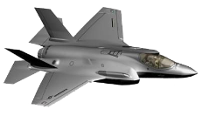
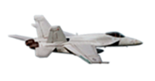

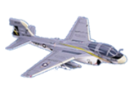
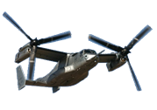

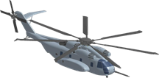
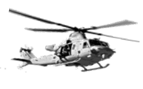



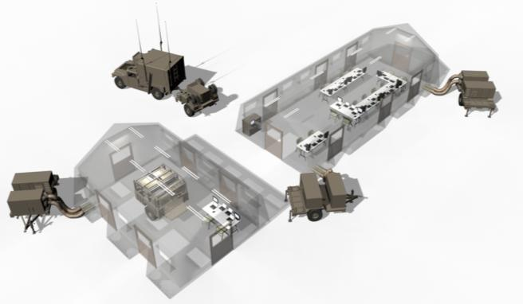

Digital Interoperability
All Marine aircraft digitally linked with
MAGTF and ship
C2
across
multiple wave-forms
FMV
ARG ship link capability
LINK-16
SUN DOWN
SRP
SRP
SRP
SRP
SRP
TPS-80
CAC2S
VMF to aircraft ECP
TACP
FY16
FY17
FY18
FY19
FY20
FY21
FY22

Slide 3
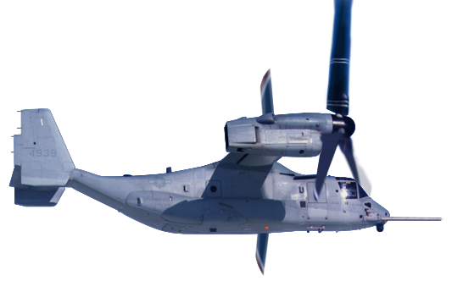

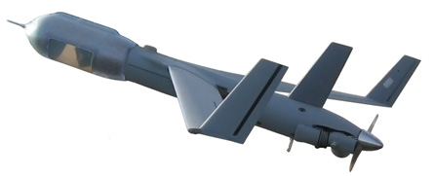
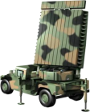





MAGTF Digital Interoperability
    Linking every platform to be a sensor, shooter, and sharer
Digital Interoperability: seamless integration of systems and exchange of data, across all domains and networks throughout the MAGTF, Naval, Joint, and Coalition forces, to include in communication degraded or denied environments, in order to rapidly share accurate information, provide greater situational awareness for commanders and decision makers, accelerate the kill chain, and enhance survivability.
  Software-defined radios, multiple waveform integration
  Encryption; NSA certification.
  Tablets with applications for exchange of text, imagery, and Full Motion Video
  “Smart logistics” & personnel tracking: low-cost RFID tabs
  UAS enabled EW and cyber fires
  Software Reprogrammable Payload radio Program of Record 2017
F-35
F-35
RF Link-16 (J-Series)
MADL
CDL
MV-22
TTNT
CNR/VMF(K-Series)
RF Link-16 (J-Series)
RF Link-16 (J-Series)
RF Link-16 (J-Series)
TTNT
MQ-21
CDL
CNR/VMF (K-Series)
C/EWCC
VMU
CDL
TAOC
DASC
FSCC
K-Series
JREAP (J-Series)
JREAP (J-Series)
K-Series
RLT COC
LHA/LHD
CAC2S Phs2 (J-K/K-J translation)
JTAC/FAC(A)

Slide 4
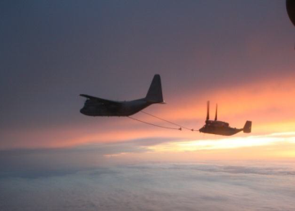
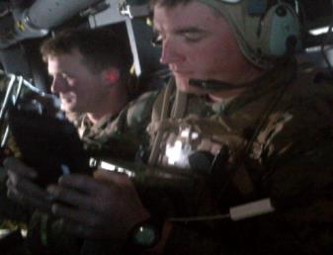
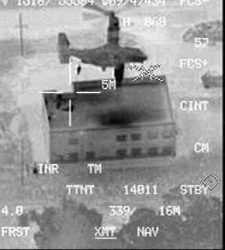
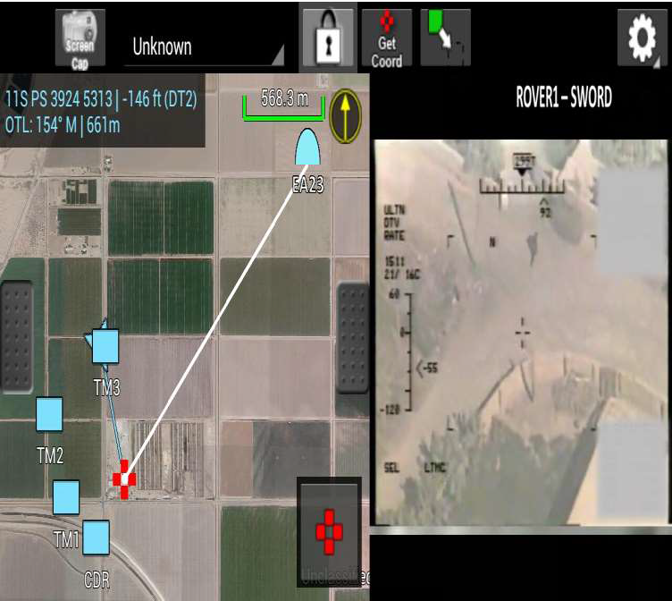
Long Range Assault Support
Digital Interoperability
~1000 miles from objective area, KC-130 air-to-air refueling extends range
~The assault force
receives situational updates while airborne
~L-Hour, Marines insert via fast rope onto objective 1100 miles from launch point
  En route communication provides shared current situational awareness between assault force and HHQs
  Harnesses SATCOM connectivity from HHQs to mission aircraft
  Provides voice, text, map, image, and full motion video for intelligence updates, collaborative planning, and mission order changes

Slide 5
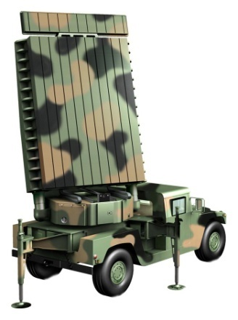


JSF TACAIR
Digital Interoperability
F-35
F-35
RF Link-16 (J-series)
MADL
F/A-18
CNR/VMF(K-Series)
CNR/VMF(K-Series)
CAC2S Phs2 (J-K/K-J translation)
VMU
MQ-21
CNR/VMF(K-Series)
Tactical Air Operations
Center (TAOC)
CTN
Node
TTNT (RaptorX)
JREAP (J-Series)
Assault Force w/ JTAC
RQ-7B
CTN
Node
C/EWCC
THS w/AFATDS (K-Series)
JREAP (J-Series)
THS w/AFATDS (K-Series)
Assault Force HQ w/ JTAC
JREAP (J-Series)
FSCC
JREAP (J-Series)
DASC
AFATDS (K-Series)
CAC2S Phs2 (J-K/K-J translation)
RLT COC
Tactical Air Command
Center (TACC)
THS w/AFATDS (K-Series)
JREAP (J-Series)
CAC2S Phs2 (J-K/K-J translation)
LAAD SLV
LAAD FUV
JREAP (J-Series)
LAAD FUV
Assault Force w/ JTAC
LHA/LHD
LAAD FUV
  Link-16 data: Tracks, targeting info, text & still-imagery
  VMF/K data: Digital Nine-Line, targeting info, text & still-imagery
  Future data: Full Motion Video; Ship integration; TTNT/NIFC-CA

Slide 6
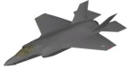
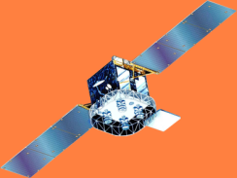
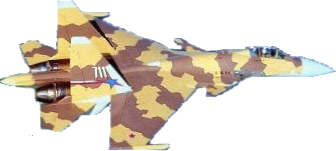
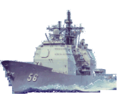
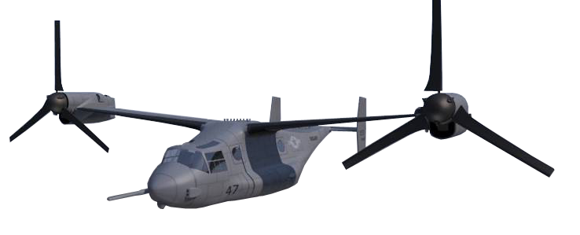
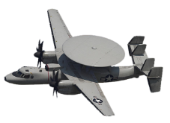
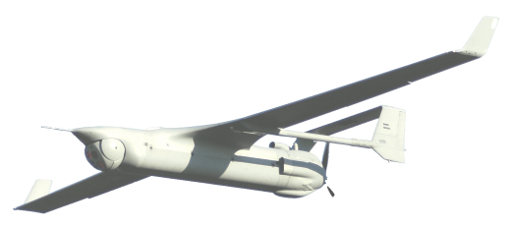
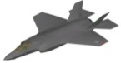


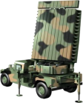


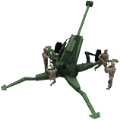

Aviation Command & Control
Digital Interoperability
DIGITAL INFORMATION PUSH and PULL to DEFEAT THREAT AND GET AHEAD OF INTERNAL FRICTION
J
CTN
fire quality data to the Navy
to protect MAGTF & sea base
Enemy 5th Gen AC
J
J
J
CAC2S
fuses real-time sensor
& link data
In TACC, TAOC, & DASC
In direct support of ACE & GCE CE
And AIRCRAFT
Enemy UAS
CEC
Enemy CM
CEC
J
High Energy laser
Low shot cost, deep magazine &
speed of light kill to defeat
hostile uas ied threat
QUED by LINK PICTURE
CTN
CAC2S
Enemy Artillery
Laser
TPS-80
TPS-80 G/ATOR
ENSURES MAGTF ownership of airspace
and C2 of SORTIES to deliver fires
Highly accurate multi-role detection of aircraft, rockets, artillery, mortars, UAS, & cruise missiles
Matched to JSF and to pace future threat systems next 35 years
Enemy Mortar Team
GCE Artillery with TPS-80
Connected by AFATDS

Slide 7
April 28th, 2015
USMC Industry Day
LtGen Jon M. “Dog” Davis
Deputy Commandant for Aviation

